Slide 1
Pet Safety/Zoonotic Diseases

Slide 2
Definitions
Zoonotic
Diseases that can be transmitted from animals to humans
Ex: Rabies
Parasite
Organisms that live on or in a host, which the parasite gets its food from
Host
An organism that the parasite lives on or in for part of it’s life cycle

Slide 3
Zoonoses
Zoonotic Diseases: More Common than You Think

Slide 4
From the Greek:
Zoon: Animal
Noson: Disease
Diseases and infections which are naturally transmitted between vertebrate animals and humans
- WHO 1959
Notes:
Interactions between animals and humans have occurred since the beginning of time.
As animals became domesticated and a close bonds developed between animals and humans, the occurrence of zoonotic diseases increased.
EX: 1700s, Mongols invaded Europe Mongols carried plague with them This lead to “black death” or plague pandemic Killed 1/3 of European population
EX: Early 1900’s “Spanish flu” transmitted from pigs to humans Decimated 20 million people worldwide Continues to pose a threat to humans
EX: Potential Human Pathogens E. coli 0157H7 Caliciviruses (evolved from the sea) Bovine Spongiform Encephalopathy (BSE) also known as “mad cow disease”

Slide 5
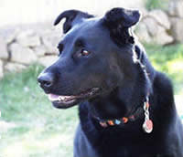
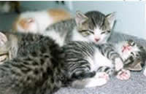
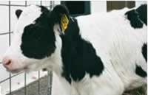
Zoonoses: Animal Species
Dogs & Cats
Rabies
Roundworm
Ringworm
Cat Scratch Disease
Food Animals
Salmonella
E.coli
Brucellosis

Slide 6
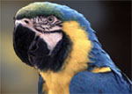
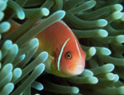
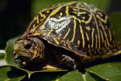
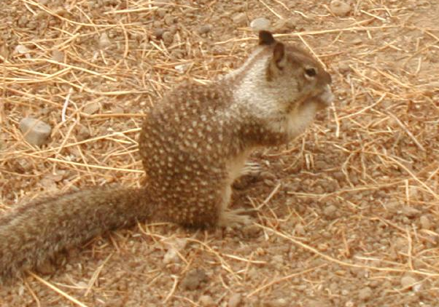
Zoonoses: Animal Species
Birds:
Psittacosis
West Nile virus
Eastern Equine Encephalitis
Avian Influenza
Reptiles, Fish, & Amphibians
Salmonella
Mycobacterium
Wild Animals
Hantavirus
Plague
Tularemia
Lyme Disease

Slide 7
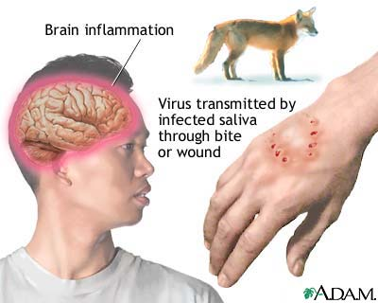
Rabies
Notes:
Rabies is a preventable viral disease of mammals most often transmitted through the bite of a rabid animal. The vast majority of rabies cases reported to the Centers for Disease Control and Prevention (CDC) each year occur in wild animals like raccoons, skunks, bats, and foxes.
First recognized by Ancient Greeks, most historically known zoonosis.
97% rabies in US is because of dog bites, most occurs in South near Mexican border. 4.7 million people are bit by dogs each year, 386,000 require emergency treatment. Most common in Asia and Africa.

Slide 8
Psittacosis (“Sit-a-co-sis”)
Notes:
Parrot Fever
Zoonose from birds to humans. All birds susceptible but pet birds such as Macaws, cockatiels, poultry and parrots are more common carriers. Contact with infected bird or their feces/ fecal dust can lead to human contact. Human symptoms are coughing, chest pain, fever, vomiting and weakness. In birds the condition can be lived with but lowers the immune system of the bird. To prevent you can have your bird tested or wear dust mask while cleaning cages.

Slide 9
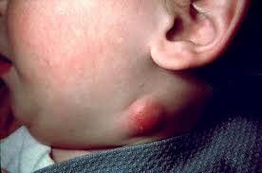
Cat-Scratch Fever
Notes:
Associated with cat scratches and bites. Affected area is swollen and slow to heal, lymph nodes also swell. Usually not serious but should be treated with antibiotics. Proper handling of cats can reduce scratches and bites.

Slide 10
Salmonella
Notes:
Usually food borne illness can occur in animals as well as humans. Symptoms in both include vomiting, diarrhea, and stomach pain. Usually appear 12-72 hours after eating. Reptiles are the most common source of animal carriers but all small animals have potential to be carriers. Proper sanitation reduces risk.

Slide 11
Streptococcal
Notes:
Cause sore throat especially in children and are transmitted by dogs. Skin conditions to life threatening conditions. 10 million cases of mild infections occur annually. Hand washing is the best way to reduce the spread of the bacteria. Infected animals can also be given antibiotics. *NOTE not all strep throat is caused by animals this is only ONE type of strain.

Slide 12
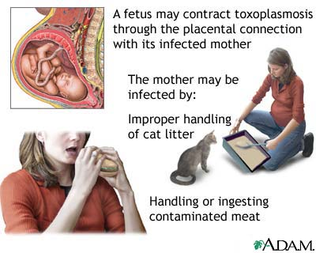
Toxoplasmosis
Notes:
Disease produced by infection with Toxoplasma gondii which is a parasite carried by many species but most commonly contracted by cat litter handling. Do NOT touch mouth after handling litter box or working with raw meat. Litter is #1 cause for spread to humans. Cats become infected after eating infected mice. MOST human infection will not develop because we carry enough antibodies to fight off disease. Those who are pregnant or sick should use additional caution – can cause defect and miscarriage. *This is why pregnant women should not change litter boxes and why sand boxes/play areas should not be used for litter boxes.

Slide 13
Safety Statistics
Children age 5-9 are the primary victims of animal bites
Too young to know safety, but old enough to not be afraid
More psychologically damaging than surgically
Less than 5% of dog bites become infected
About 50% of cat bites become infected
More difficult to clean out the wound

Slide 14
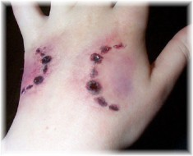
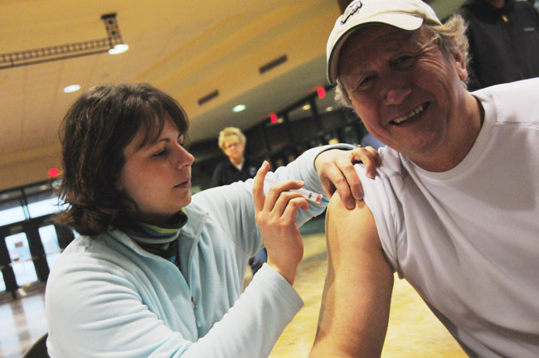
Safety Statistics
All animal bites and scratches should be washed immediately
If you are in frequent contact with animals you should receive a tetanus shot every 5 years

Slide 15
Skin Disease Caused By Fungus ……

Slide 16
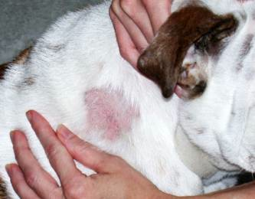
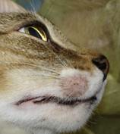
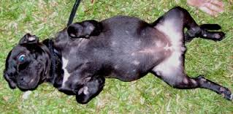
Ringworm
Notes:
Ringworm is common, especially among children. However, it may affect people of all ages. It is caused by a fungus, not a worm like the name suggests.
Many bacteria and fungi live on your body. Some of these are useful, while others can cause infections. Ringworm occurs when a type of fungus called tinea grows and multiplies on your skin. EXTREMLY CONTAGIOUS. ALL small animals can be infected as well as humans, so contagious. Direct contact or indirect (clothing, blankets, mats). Symptoms are round, scaly or encrusted lesions on skin, usually with hair missing. Must see vet for topical antifungal drugs.

Slide 17
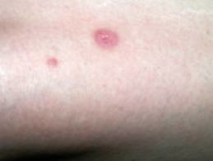
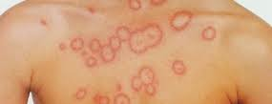

Slide 18
Parasites

Slide 19
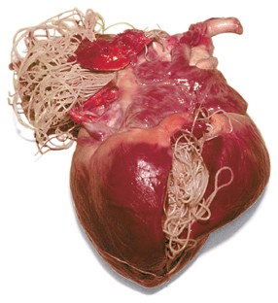
Heartworm
Notes:
Heartworm disease is a serious and potentially fatal condition caused by parasitic worms living in the arteries of the lungs and occasionally in the right side of the heart of dogs, cats and other species of mammals, including wolves, foxes, ferrets, sea lions and (in rare instances) humans. Heartworms are classified as nematodes (roundworms) and are filarids, one of many species of roundworms. Dogs and cats of any age or breed are susceptible to infection

Slide 20
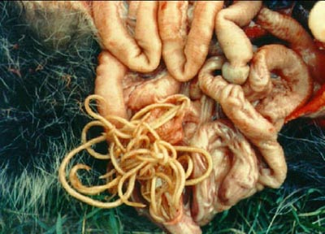
Roundworm
Notes:
Roundworms, or nematodes, are a group of invertebrates (animals having no backbone) with long, round bodies. They range in size from those that can be seen by the naked eye to those several hundredths of an inch long that can only be seen under a microscope.
Wash hands after handling animals and feces to protect from being infected.
Live in digestive system of animals and humans and cause illness. Symptoms in humans include: fever, headache, cough and poor appetite.

Slide 21
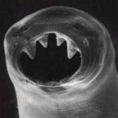
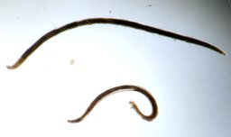
Hookworm
Notes:
Hookworm is a condition caused by roundworms that affects the small intestine and lungs.
Hookworm disease is common in the moist tropics and subtropics. It affects about 1 billion people worldwide and countless more animals. In developing nations, the disease leads to the death of many children by increasing their risk for infections that their bodies would normally fight off.
There is very little risk of getting the disease in the United States because of advances in sanitation and waste control. The important factor in getting the disease is walking where people who have hookworm have made feces. Can be found in some US animals but again not as common. Larvae penetrate skin and leave inflamed tract as they travel under the skin of animals before making way to intestines.

Slide 22
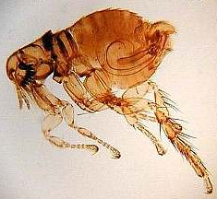
Flea
Notes:
Wingless insects with mouthparts that are adapted to pierce skin and suck blood. External parasites common in stray cats and dogs as much pet owners protect against fleas, over 2,000 species of fleas world wide. Not all will be zoonotic (ex: chicken fleas do not effect humans and dog fleas rarely do. ) Must wash and sanitize everything if you have fleas because they can live without food for up to 4 months (females do need blood to reproduce, then lay 4,000 eggs)

Slide 23
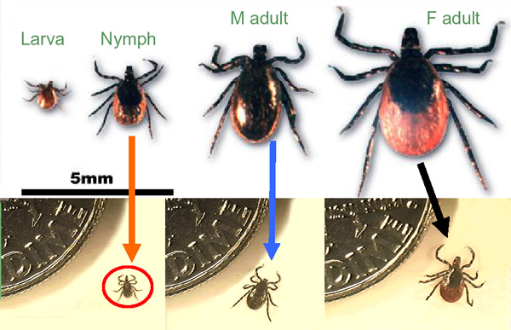
Deer Tick
Notes:
Ticks are frequent carriers of disease and can cause illness in animals and people. A bitten animal will not pass infection on to a human but could transport the tick from one place to another where it may later bite a human. Rocky Mountain Spotted Fever and Lyme Disease are the two most commonly spread diseases. Early diagnosis is the key for both animals and humans. If you see the tick and can remove it do so. Be sure to get all parts of it out or see a doctor/vet to do so.

Slide 24
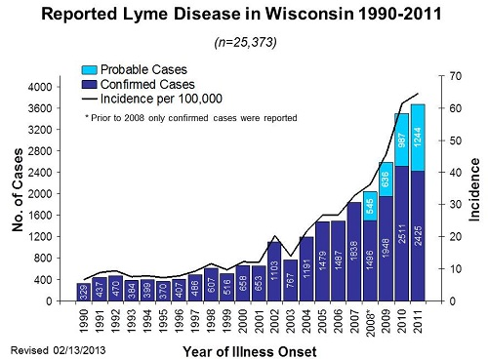
Lyme Disease
Notes:
Tick transmitted disease first discovered here in WI in 1969, in 1977 a group of students in Lyme Connecticut had the same symptoms/disease which is where the name came from. Growing threat as it is not in 47 states, Alaska, Hawaii and Montana = not.
90% of cases occur in 10 states of which WI is one. 3 species of ticks carry but deer tick is most prevalent in our area. Skin lesion appears 3 to 32 days after bite, vaccinations are needed, flue like symptoms, damages organs and can cause death.
Those who allow pets outside especially in wooden and grassy areas and humane society workers are at a higher risk.

Slide 25
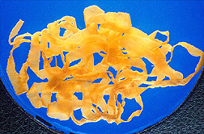
Tapeworms – Intermediate Host
Notes:
Infection of digestive tract which are sometimes carried by cats and dogs and can be fatal. Fox and mice were first carriers now seen in some cats and dogs. Most common host is a mouse but is not killed upon temperature change or time so can be passed through intermediate hosts.

Slide 26
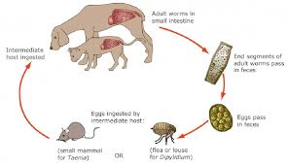
Echinococcus miltilocularis Life Cycle

Slide 27
Discussion Questions
What is the difference between a zoonose and a parasite?
What is a host? Intermediate host?
How should a tick be removed?
Why are children more at risk?
Why shouldn’t pregnant women change litter?
Explain a zoonose to a friend.
Explain a parasite to a friend.

