Slide 1
Veterinary Science CDE
Equipment Identification Powerpoint

Slide 2
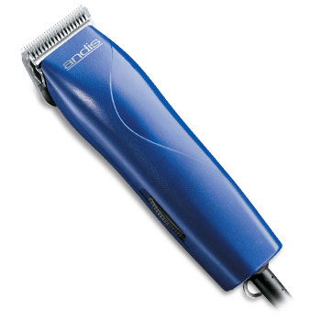
Animal Clippers

Slide 3
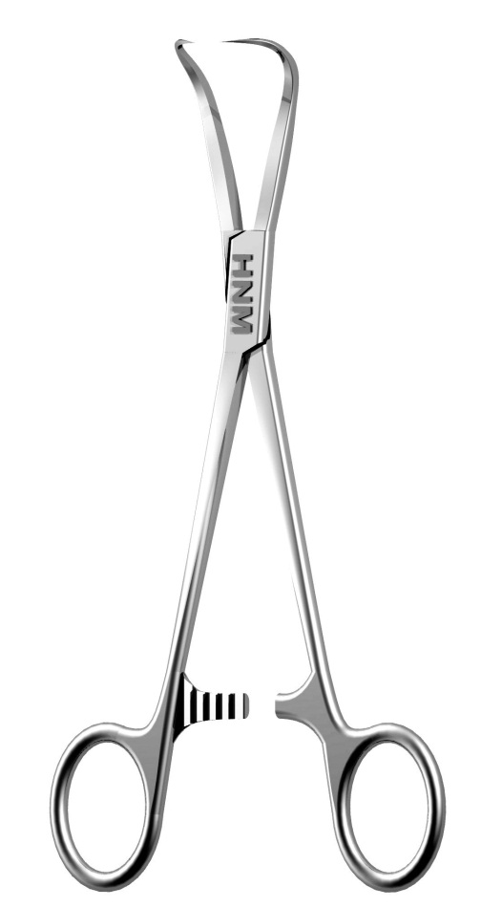
Backhaus Towel Clamps

Slide 4
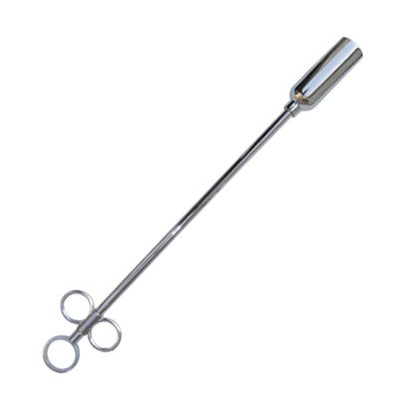
Balling Gun

Slide 5
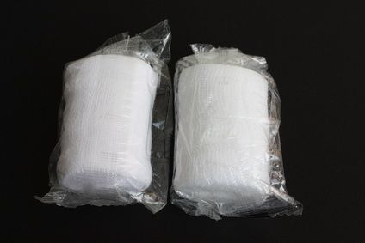
Bandaging material – Roll gauze

Slide 6
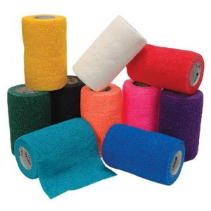
Bandaging Material – Vet Wrap

Slide 7
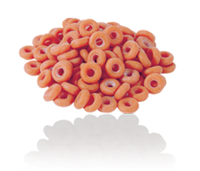
Bands (castration or docking)

Slide 8
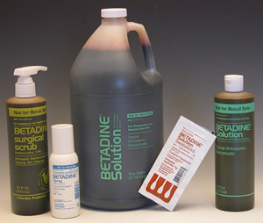
Betadine

Slide 9
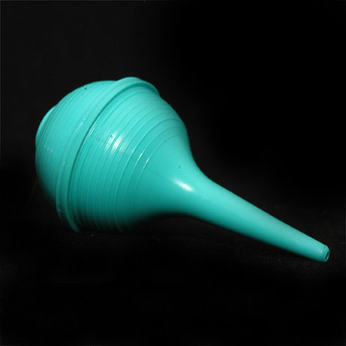
Bulb Syringe

Slide 10
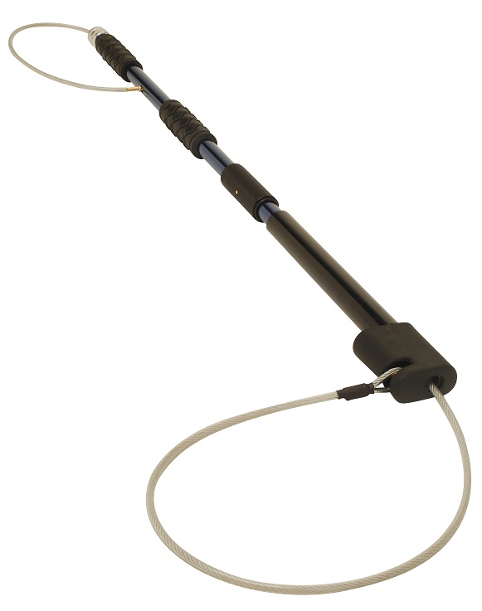
Catch pole (dog snare)

Slide 11
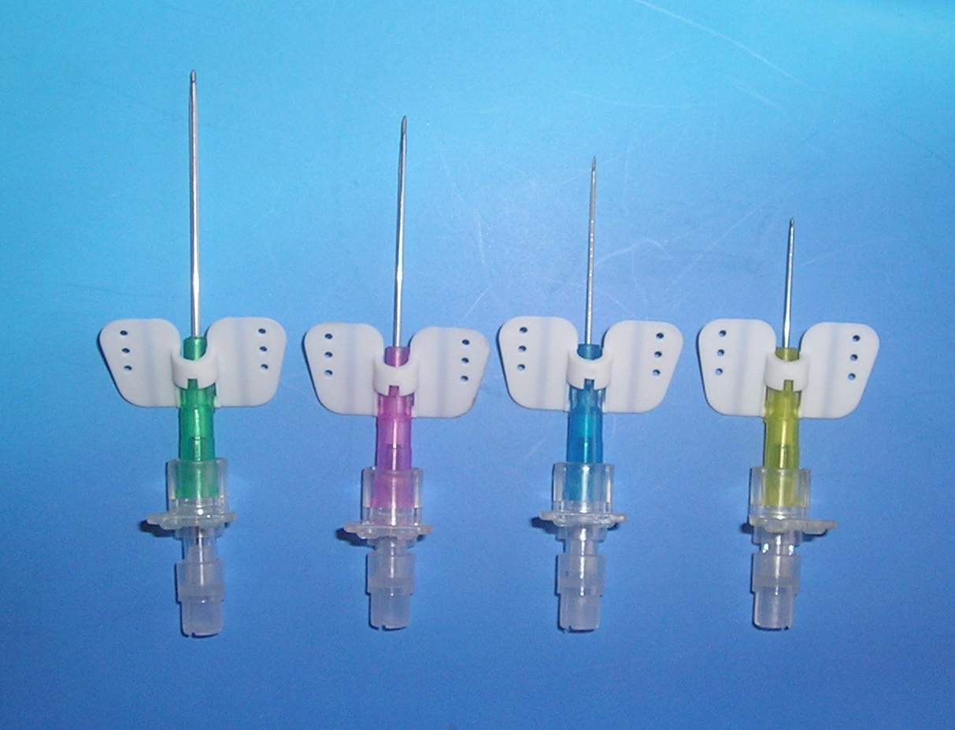
Catheter – butterfly

Slide 12
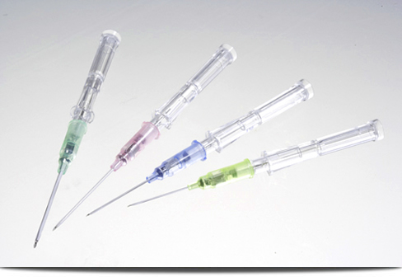
Catheter – IV

Slide 13
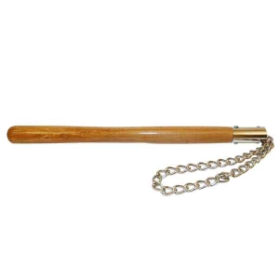
Chain twitch

Slide 14
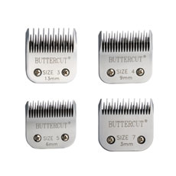
Clipper Blades

Slide 15
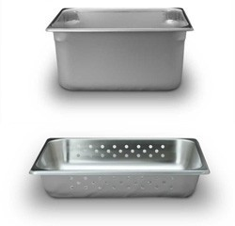
Cold sterile tray

Slide 16
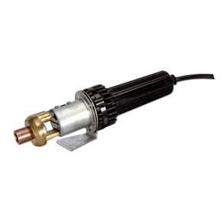
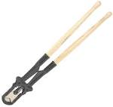
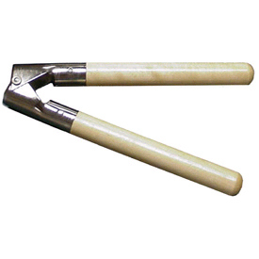
Dehorner

Slide 17
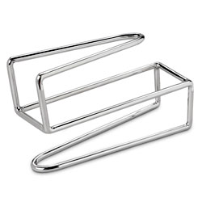
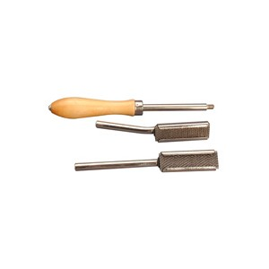
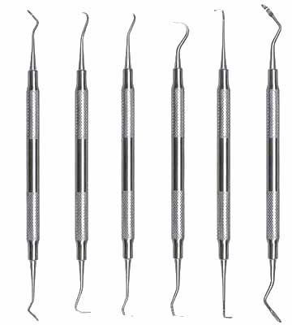
Dental equipment (float, retractor or scaler)

Slide 18
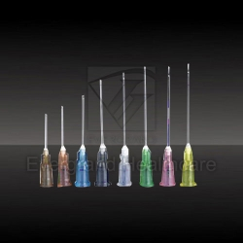
Disposable hypodermic needles

Slide 19
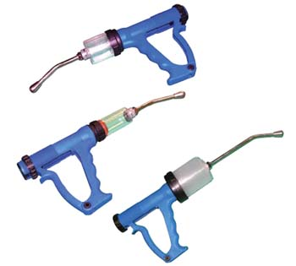
Drench gun

Slide 20
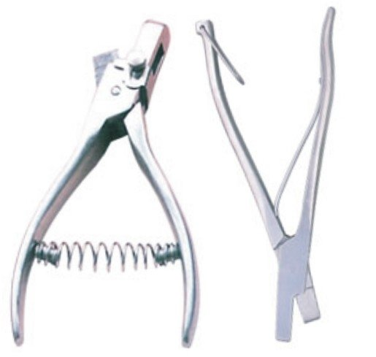
Ear notcher

Slide 21
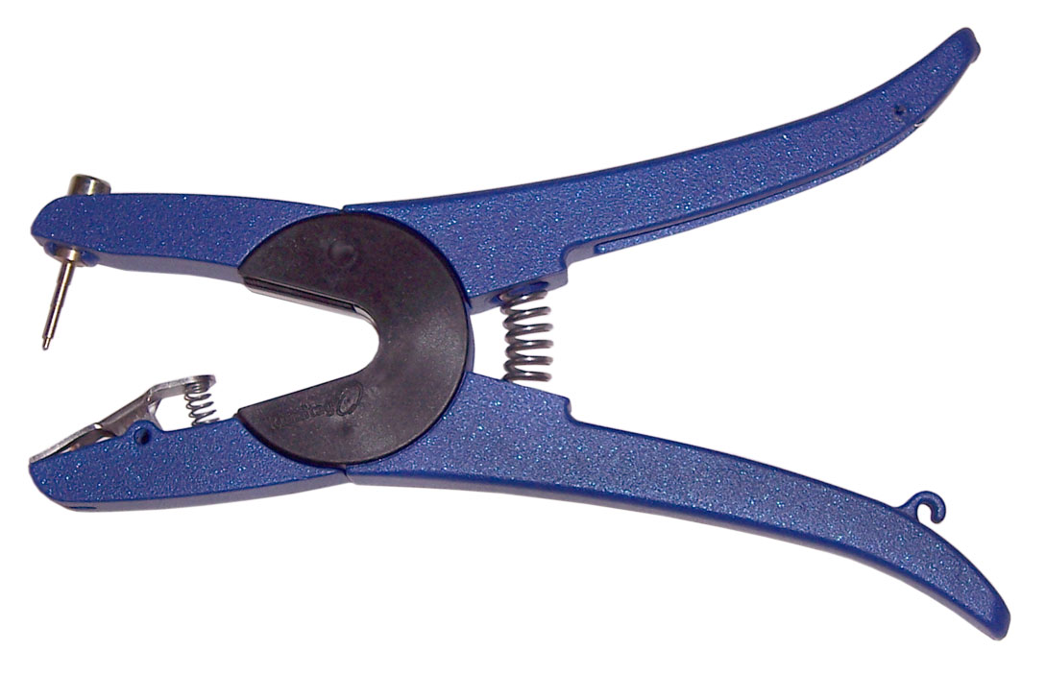
Ear tag pliers

Slide 22
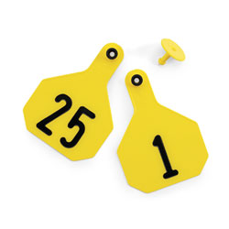
Ear tags

Slide 23
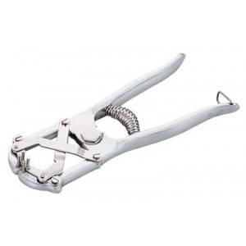
Elastrator

Slide 24
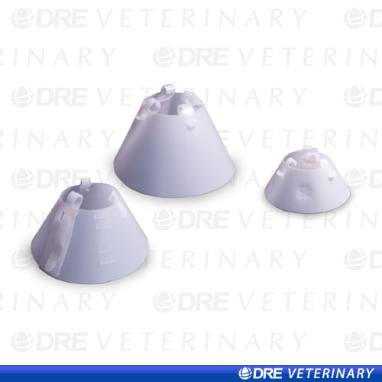
Elizabethian collar

Slide 25
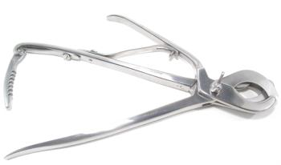
Emasculators

Slide 26
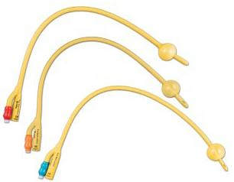
Endotracheal tubes

Slide 27
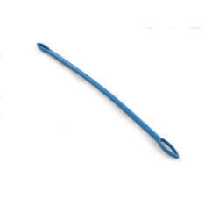
Fecal loop

Slide 28
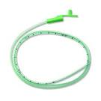
Feeding tube for small animal

Slide 29
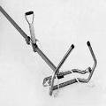
Fetal extractor

Slide 30
forceps

Slide 31
Gag mouth speculum

Slide 32
Halter and leadrope

Slide 33
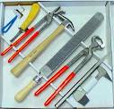
Hoof equipment

Slide 34
Iv equipment

Slide 35
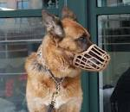
Muzzle (commercial)

Slide 36
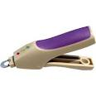
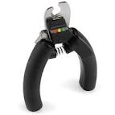
Nail clippers

Slide 37
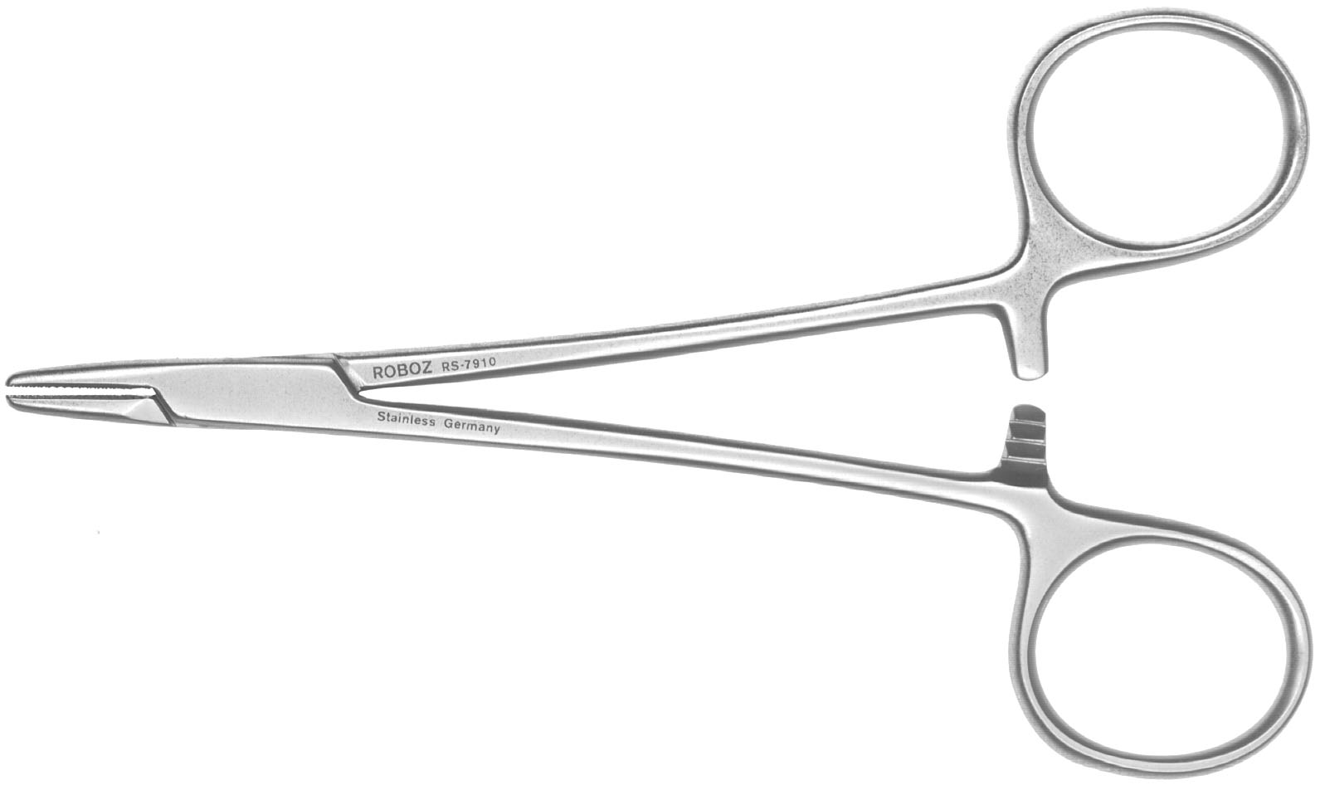
Needle Holder

Slide 38
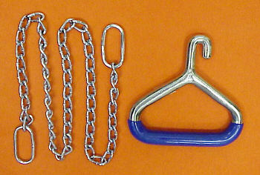
Obstetrical Chain and Handle

Slide 39
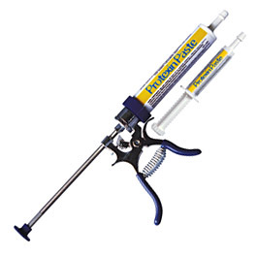
Paste Gun

Slide 40
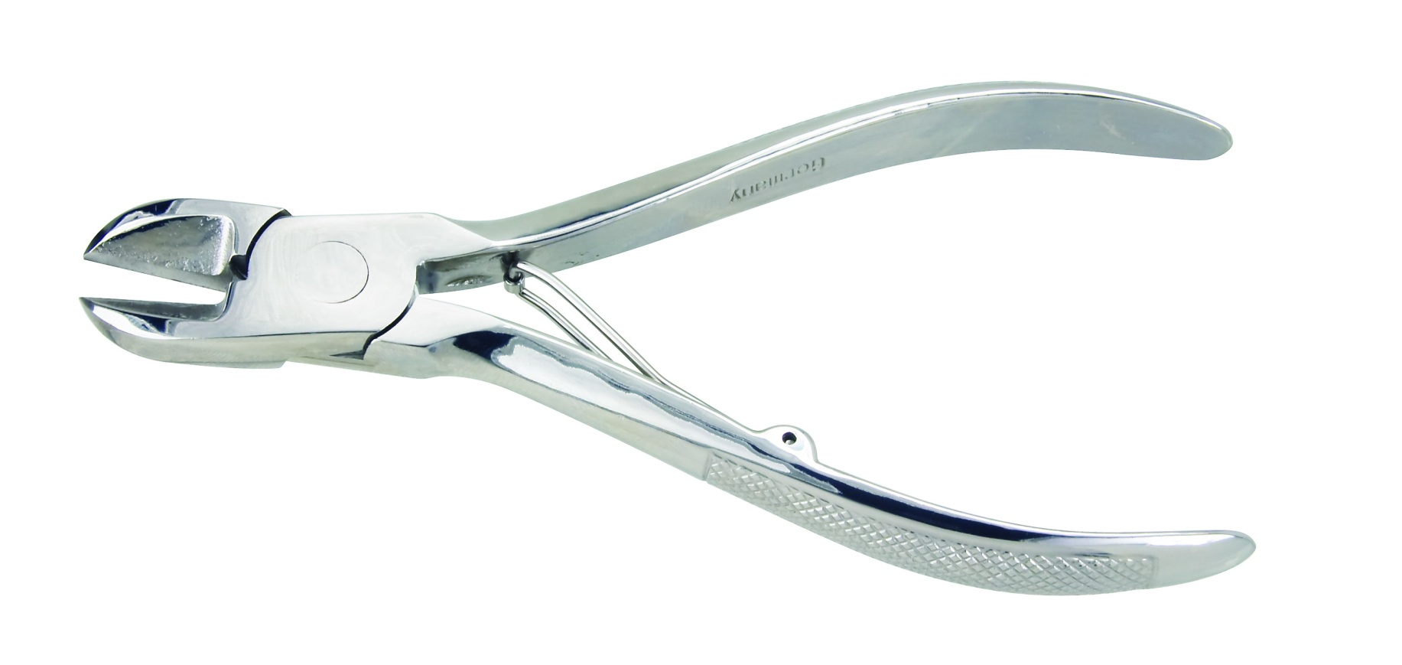
Pig Tooth Nippers

Slide 41
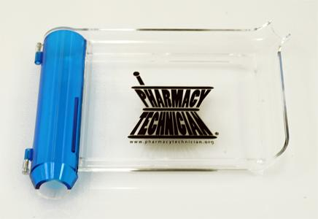
Pill Counting Tray

Slide 42
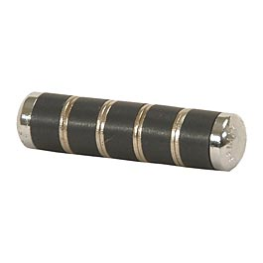
Rumen Magnet

Slide 43
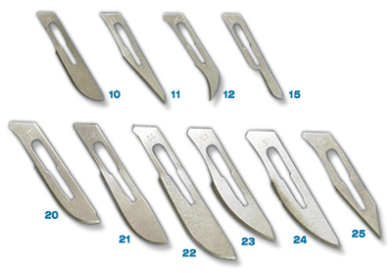
Scalpel Blade

Slide 44
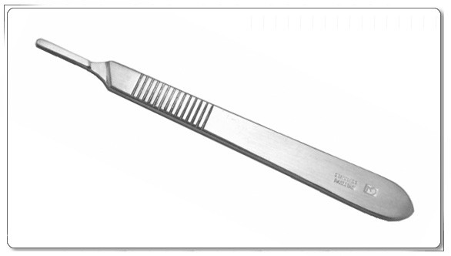
Scalpel Handle

Slide 45
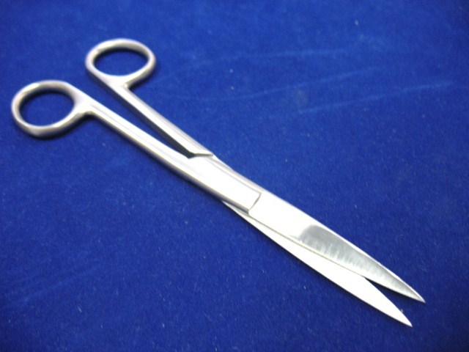
Scissors

Slide 46
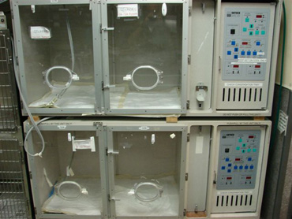
Silver Nitrate Oxygen Cage

Slide 47
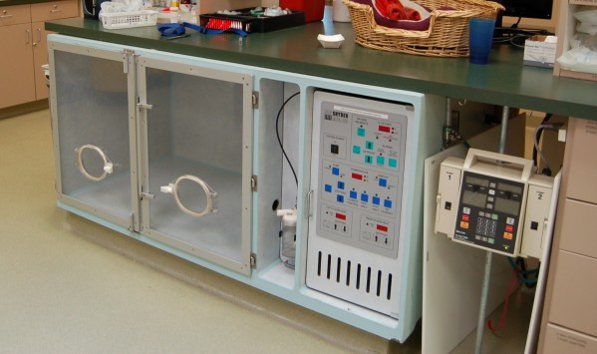
Small Animal Oxygen Cage

Slide 48
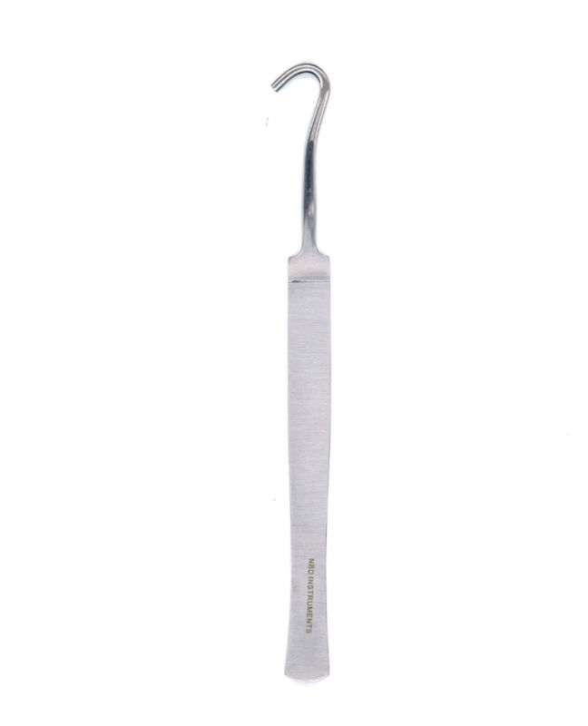
Snook ovariohysterectomy hook

Slide 49
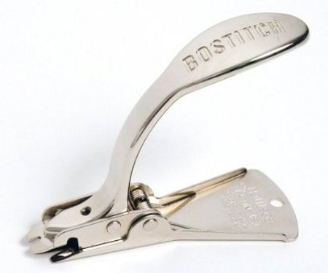
Staple remover

Slide 50
Stethoscope

Slide 51
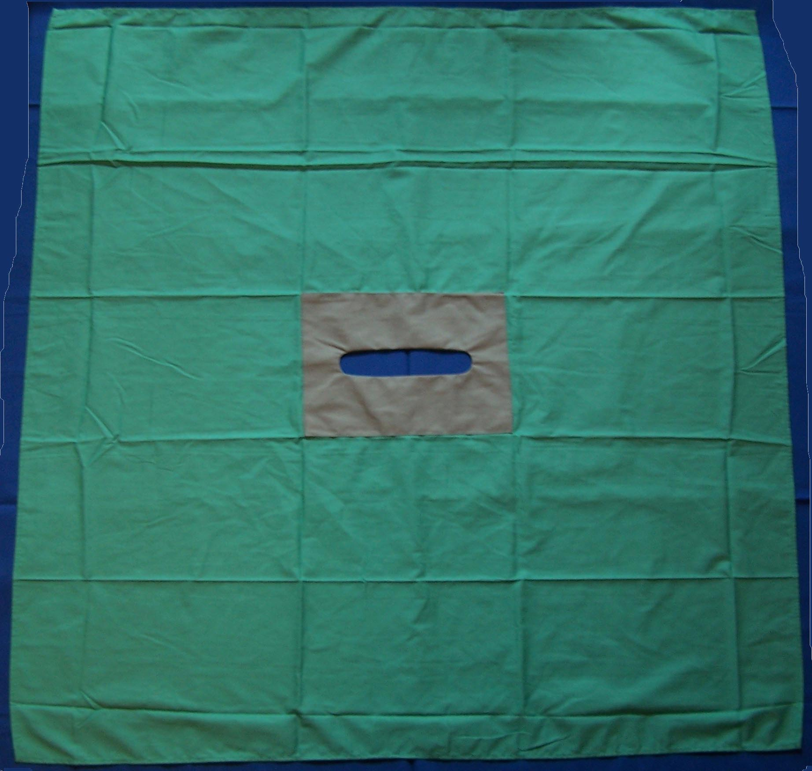
Surgical drapes

Slide 52
Surgical personal protective equipment)

Slide 53
Surgical tray

Slide 54
Suture equipment

Slide 55
Syringe

Slide 56
Tattooing instruments-small & large

Slide 57
Tourniquet

Slide 58
Weight tape

