Slide 1
Regulating Plant Growth Plant Hormones

Slide 2
Plant Hormones
Naturally occurring compounds produced by the plant to accelerate or inhibit the rate of growth or maturation
Produced in minute quantities, but can have a large affect on growth
Can be synthesized

Slide 3
Plant Growth Regulators
Organic compounds, either natural or synthetic, that control one or more plant processes

Slide 4
Plant Hormone Uses In Ag
Promote rooting in cuttings
Thin flower blossoms allowing for larger fruit
Produce seedless fruits
Stimulate flower development
Increase cut flower life
Ripen fruit
Slow stem elongation creating a stronger stem
Control weed growth as herbicides
Genetically modifying plants to control weeds

Slide 5
Plant Hormones
Auxins
Growth promoting
Produced in apical meristem (young leaves and stems)
Promotes terminal bud growth and prevents axillary/lateral bud growth leading to apical dominance
Poinsettia and geranium growth affects
Stimulates rooting on cuttings
Very high levels act as an herbicide

Slide 6
Plant Hormones
Cytokinins
Growth promoting
Produced in root tips
Stimulates cell division
Stimulates axillary/lateral bud growth
Poinsettia and geranium growth affects

Slide 7
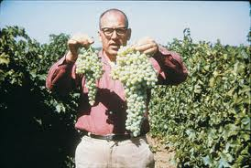
Plant Hormones
Gibberellins
Growth promoting
Produced in young parts of a plant
Stimulates stem growth by inducing stem elongation and cell division
Promotes flower and fruit development

Slide 8
Plant Hormones
Abscissic Acid
Growth inhibiting
Produced in leaves, stems, and unripe fruit
Causes stomas to close
Promotes plant and seed dormancy
Causes leaves to drop

Slide 9
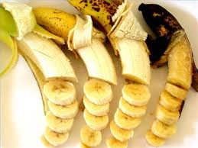
Plant Hormones
Ethylene
Growth inhibiting
Produced in ripe fruit
Promotes fruit ripening
Causes leaves, flowers, and fruits to drop

Slide 10
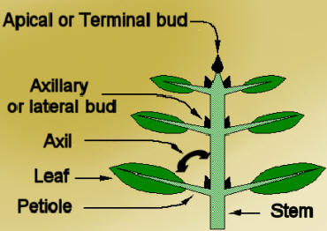
Apical Dominance
Terminal bud grows, axillary/lateral buds do not grow
Controlled by ratio of Auxins to Cytokins

Slide 11
Plant Tropisms
Phototropism
Growing towards light
Caused by auxins
Geotropism/Gravitropism
Growing towards gravity
Caused by auxins

Slide 12
Lab Activities
Geranium Growth Lab
When the geraniums reach 4-5 inches tall, select 4 similar plants
On 2 plants remove the top 2 inches of the terminal bud (auxins) and leave the other 2 plants as is
Compare the growth for the next two months

Slide 13
Lab Activities
Geranium Rooting Lab (Auxin)
With all the cuttings taken from our geraniums treat half with a rooting hormone and leave the other half untreated
Every 7-10 days pull several cuttings and compare root development and growth

Slide 14
Lab Activities
Fruit Ripening Lab (Ethylene)
Need 2 bananas, 2 pears, 2 apples (as unripe as possible) and 4 bigger containers to hold the fruit
In 1 container place a banana, pear, and apple
In the other 3 containers place 1 fruit in each
Evaluate ripeness every week for four weeks

Slide 15
Lab Activities
Plant Growth Regulator Paste Lab (Gibberellins)
Plant several pea seeds of both tall and dwarf varieties
When the seedlings about 1 inch tall, split each variety of seed into 3 groups. Treat 1/3 of the seeds with B-Nine (Antagonist to Gibberellin), treat 1/3 with Gibberellic Acid and leave the remaining 1/3 as the control
Measure plant height daily for one week and compare results

