Slide 1
Pet Obesity
By C. Kohn, Waterford Agricultural Sciences
Based on “Pet Obesity is a Growing Concern” by Ann Falk, U. of Illinois, and “Nutritional Management of Weight”, Virginia Tech and U. of Maryland

Slide 2
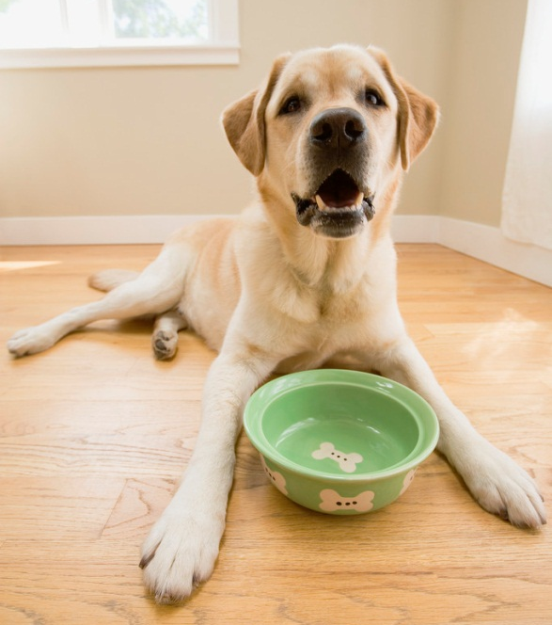
Pet Obesity
Pet obesity affects as many as 40% of dogs in the US
  While pet obesity may seem like a minor problem, it can result in serious health implications for pets.
Overweight pets are at greater risk for developing diabetes (the reduced or lost ability to regulate blood sugar levels), heart disease, respiratory disorders, and arthritis.
  An overweight pet is more
  susceptible to hip disorders,
  back problems, and
  hormonal disorders.

Slide 3

Cost of Obesity
A lean pet is expected to live up to 2 years longer on average than an obese pet.
  Because animals at a healthier weight are less likely to have chronic disease, they are more likely to live longer.
A pet with a healthy weight will be likely to have fewer expenses for their owner.
  A pet with less disease has fewer expensive treatments and trips to a vet.
Simply put, an animal at a healthy
weight will be happier, stronger,
live longer, and be less expensive
to care for.

Slide 4

Causes of Obesity
Obesity occurs only when the consumption of calories exceeds the use of calories.
  In other words, when a pet eats more than they burn off, the excess calories will be stored as fat.
  This does not require an excessive amount of calories to cause obesity.
An extra small treat or a bowl filled a little too full each day will have consequences that will accumulate over time.
  Obesity typically occurs from
  slightly overfeeding over long
  periods of time.
  This can make the causes of obesity
  harder to spot.

Slide 5

Modern Day Pets
Over-caring owners, in combination with an inactive lifestyle, have resulted in a huge problem.
Pets on average are simply receiving more calories than in previous years while getting fewer opportunities to burn off the same amount of weight.
The result of too many calories and too
little activity is a higher risk for chronic
disease, higher veterinary bills, and a
shortened lifespan on average due to
pet obesity.

Slide 6

Checking for Obesity
Checking for obesity is not as simple as weighing your pet.
  This number will provide you with relatively little information.
  There is no single healthy weight for dogs or even for a breed of dog just as there is no single healthy weight for humans
A more thorough approach to
determining whether your animal
is at a healthy weight is to determine
the dog’s Body Condition Score.

Slide 7
Checking the BCS
There are a number of methods to determine the Body Condition Score (BCS) of your pet.
  The BCS Score is a determination of the overall health of an animal’s body mass and body fat.
A pet with ideal conditioning (body weight) will have ribs that can be felt easily without pressing but that do not show through their coat.
  If you cannot easily palpate (physically feel) a dog’s ribs, they are most likely obese.
The second check for determining the
BCS is the waistline of a pet.
  An obese pet will have a waistline
  that is indistinguishable from their
  thorax (chest).
  A healthy dog will have a “tuck”
  in its stomach that clearly separates
  it from the chest

Slide 8
A second check of the BCS
This tuck is visible both from the side as well as from above.
The “tuck” of the abdominal area creates a sort of hourglass shape when viewed from above
  The chest and hips form the widest part of the hourglass and the abdomen forming the narrow “neck” of the hourglass.
If the chest flows smoothly into
the abdomen with no
distinguishable separation, the
dog is most likely obese.

Slide 9
BCS Check #3
Final areas to check are the tail head (base of the tail) and spinal vertebrae along the back.
  A dog at an optimal BCS will have a smooth tail base that doesn’t feel bony to the touch.
  Their vertebrae will be easily detectable with a slight covering of fat.
While it can be hard to be objective when checking your own animal, the signs of obesity can usually be detected with a careful eye.
  Assume your dog is obese if you are unsure.
  A consultation with a veterinarian is always best in order to ensure the health of your animal before making any decisions.

Slide 10
BCS Scoring
Texas A & M College of Veterinary Medicine has published a BCS Guide to assist in determining what a dog’s BCS would be on a 5 point scale.
  The optimal ideal score is a 3.
  Each point above or below a score of 3 indicates an animal that is 20% under- or overweight.
Occasionally a BCS scale will run from 1-9, with 5 as the optimal score and each point 10% from optimum.
1
3
5

Slide 11
BCS Descriptions
1. Emaciated: Ribs and lumbar vertebrae obvious, pelvic bones and all other bony structures obvious and prominent. Tail base prominent and bony. Accentuated concave abdominal tuck Accentuated, severe hourglass shape to waist. No discernible body fat. Obvious loss of muscle mass.
2. Thin: Ribs and lumbar vertebrae easily seen with no fat cover. Pelvic bones obvious. Tail base bony with little soft tissue. Marked concave abdominal tuck. Marked hourglass shape to waist.
3. Optimal: Ribs, lumbar vertebrae, pelvic bones and other bony structures easily palpable with slight fat cover. Tail base smooth with thin, soft tissue cover. Concave abdominal tuck. Smooth hourglass shape to waist.

Slide 12
BCS Descriptions
4. Fat: Ribs and lumbar vertebrae are difficult to palpate. Pelvic bones are palpable with moderate tissue cover. Tail base has fat deposition with moderate soft tissue cover. Concave tuck is decreased to absent. Loss of hourglass shape to waist with back slightly broadened.
5. Obese: Ribs and lumbar vertebrae are very difficult to impossible to palpate. Pelvic bones are difficult to palpate with thick tissue cover. Tail base is thickened from fat deposition with thick soft tissue cover. Abdomen is convex with or without a pendulous ventral bulge. Back is markedly broadened.

Slide 13
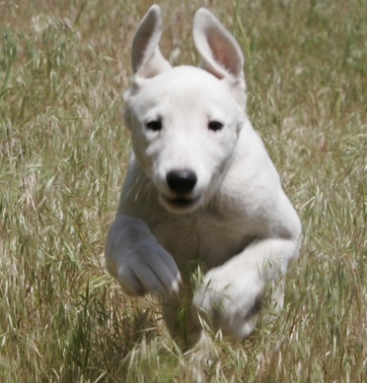
Treating Obesity
So what do you do if your dog is obese or overweight?
  The first step is to contact your veterinarian. A weight-loss program should never be started without the approval of a medical professional.
A weight-loss plan should accomplish two goals:
  1) steady, weight loss until a healthy weight is reached
  2) sustained pet comfort and
  satisfaction. In other words,
  while a pet should lose weight
  on a well-managed plan, they
  should also remain comfortable
  throughout the process.

Slide 14
Rates of Weight loss
The Virginia-Maryland College of Veterinary Medicine recommends that pets lose no more than 2% of their body weight per week.
  Rates above 2% can cause hunger, a slowed metabolism (making it harder to shed weight pound for pound), and lost muscle tissue.
The best evidence for veterinarian to use in a diagnosis and treatment is the current caloric intake of the animal.
  A diet history consisting of an accurate list and amount of all types of food and treats a dog consumes is necessary for a veterinarian to make educated decisions that are in the best interests of the animal.
  Regular weight-checks during the weight-loss period will be necessary to ensure a consistent result.

Slide 15

Dog food for obesity
Because obesity is caused primarily by excess calories and not necessarily by the actual volume of the food consumed, veterinarians who place dogs on diets will often recommend a change in the dog’s food.
  The top goal is for the dog to lose weight without feeling hunger.
This may mean switching to a less nutrient-dense food so that the dog can consume the same amount without the same number of calories.
  Most veterinarians will chose a special
  low-calorie dog food specifically
  designed for weight loss.
  Switching to this kind of low-calorie dog
  food will enable the animal to consume
  the same volume with fewer calories.

Slide 16
Low-calorie dog foods
Simply reducing a pet’s caloric intake without any special modifications or changes can put the animal at risk.
  Reducing an animal’s intake by 30% can also reduce their nutrient intake by 30%, creating an increased likelihood of health disorders.
  This makes specially-designed dog foods a necessity, even if it may come at a greater cost.
It is vital that the low-calorie dog food have the same amount of essential amino acids, fats, vitamins, and minerals so that the dog does not experience a deficiency that could threaten their health.

Slide 17
Obesity and Treats
Treats should not be eliminated from a dog’s diet if they are overweight or obese.
  Treats provide a pet with feedback and positive reinforcement, allowing them to feel as if they are an important part of your family.
  Treats should never account for more than 10% of a dog’s daily caloric intake.
Talk with a veterinarian to determine exactly what kinds of treats should be used for positive reinforcement in dogs on a diet.
  For example, 1 tablespoon of peanut butter has the same number of calories as 3 cups of air-popped popcorn without butter.
  Treats should be carefully selected and given only to reinforce correct behavior in a dog.

Slide 18
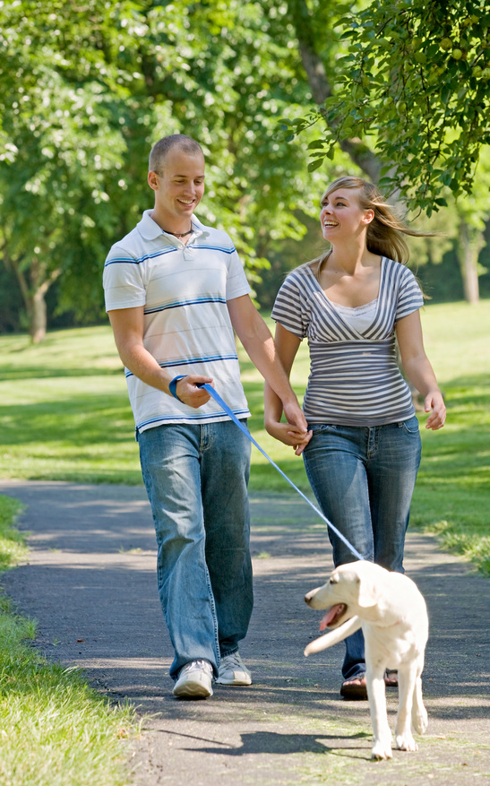
Exercise
Modifying a dog’s diet is only half the battle in managing their weight or returning it to a proper level.
  Exercise is the other half of this approach and is equally important.
The best overall exercise for your
dog is having them walk by your
side at a moderate pace.
  This is also great exercise for you!
  Regular exercise in both dogs and
  people stimulates tissue and
  increases circulation.

Slide 19
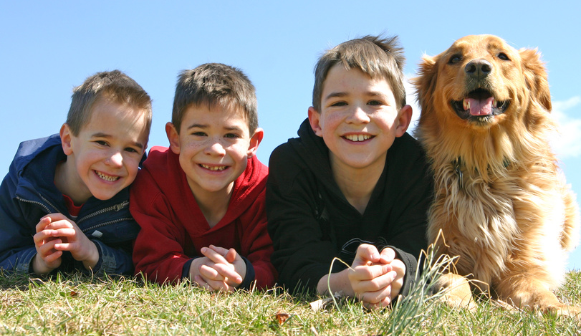
Obesity & Exercise
The additional flow of oxygen through a body as a result of exercise also works to remove toxins from the body.
  A dog’s digestive tract will benefit from increased secretion of fluids, enabling better bowel movements.
  Finally, it can increase the bond between you and your pet, reducing their anxiety and increasing your enjoyment together.

Slide 20

Starting an Exercise Program
If you are just starting an exercise program with a pet who has not recently exercised, you will want to start with short frequent walks and gradually increase their length.
  Research has indicated that two 20-minute walks per day can help maintain a healthy weight in dogs.
  You will need to make decisions
  on what is appropriate for your
  animal based on your pet’s abilities,
  a veterinarian’s advice, and your
  own personal schedule.

Slide 21
The Psychology of Exercise
It is important that you make your walks with your dog a pleasant experience for both you and the animal.
  These walks are as necessary for their physical health as well as their mental health.
Dogs have adapted a keen ability to sense human emotion due to 10,000 years of domesticated breeding.
  A dog will be able to sense if you are rushing to finish, or if you dread this time as just another chore.
It is important for both the health of the dog as well as your relationship that you find ways to enjoy your time together and build your bond with your animal.
  Walking through new neighborhoods, adding a ball or Frisbee to the routine, or simply exploring a park or woods will improve your dog’s physical well-being as well as their emotional and mental health.

Slide 22
Prevention
Prevention is the best way to address pet obesity.
  Keeping animals at a healthy weight is a much easier and much cheaper alternative.
  An animal that develops arthritis or diabetes due to obesity will struggle much more to reach a healthy weight.
Regardless of the condition of your animal, you should monitor their BCS routinely, adjust their food accordingly, and regularly consult your vet with checkups and examinations.
  Always remember that obesity can be a sign of problems other than excessive caloric intake, and regular checks of an animal’s BCS can help catch problems that are unrelated to digestion, including glandular disorders and injuries.

