Slide 1
Bandaging
Originally Created By Craig Kohn
Modified By Jamie Propson

Slide 2
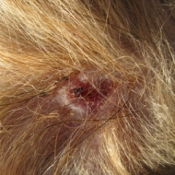
Not all wounds heal equally.

Slide 3
Not all wounds heal equally.
Not all wounds heal equally. More-serious wounds take longer to heal.
Individual factors also influence how quickly your body is able to recover from a wound, including the following:
Age — younger pets usually heal faster than older pets
Nutrition — a pet’s body needs a good supply of vitamin C to make collagen. Over-conditioned pets will heal more slowly
Smoking — if an owner smokes, the healing rate of a pet will decrease
Stress — large amounts of stress can delay the healing process (poor diet, poor care, improper bedding, etc.)
Other infections or illnesses — diabetes, thyroid disease, high blood pressure, and poor circulation etc., can decrease a pet’s healing.
Source – Columbia University Health Services

Slide 4
Why do we use bandages?

Slide 5
Bandages
I) Bandages promote healing by:
Controlling bleeding and aiding hemostasis
Absorbing seepage; protects the wound from infection and drying
Decreasing the possibility of self trauma & self-inflicted injury
Decreasing swelling and edema (pooling of fluid under the wound)
Source: Clinical Textbook for Veterinary Technicians 7th ed by McCurnin and Bassert, pgs. 1239-1243, 1249-1264

Slide 6
Bandages and Fit
Bandages must be applied carefully and must be fit to the wound.
Signs of improper bandage fit and/or problems include: 1) swelling above or below bandage 2) redness or discoloration of skin near bandage 3) odor 4) moisture 5) excessive chewing or licking

Slide 7
Bandages TOO Tight

Slide 8
Check Bandage for Tightness

Slide 9
Rules of Bandaging
Bandages must be changed every day or two
The wound must be kept clean and dry between changes
Swelling above or below the bandage means its too tight.
If your pet suddenly starts licking or chewing the bandage, or if there’s a bad smell, remove the bandage immediately to be sure there is not an infection or other problem.
Bandages are a short term solution until treatment from a vet is available.
- If a bandage is needed, most likely a veterinarian will need to be seen

Slide 11
Parts of a Bandage
Bandages have 3 parts
Absorbent Pad – Primary Layer
Gauze – Secondary Layer
Tape – Tertiary Layer
All three are needed for an effective bandage

Slide 12
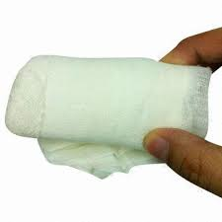
Absorbent Pad
Absorbent Pad
This part is necessary to prevent infection and reduce “stickage”
Sterile nonstick pads like Tefla work best; any absorbent material that is clean and lint free is fine
Paper towels and other paper products tend to stick to wounds and can cause damage when removed

Slide 13
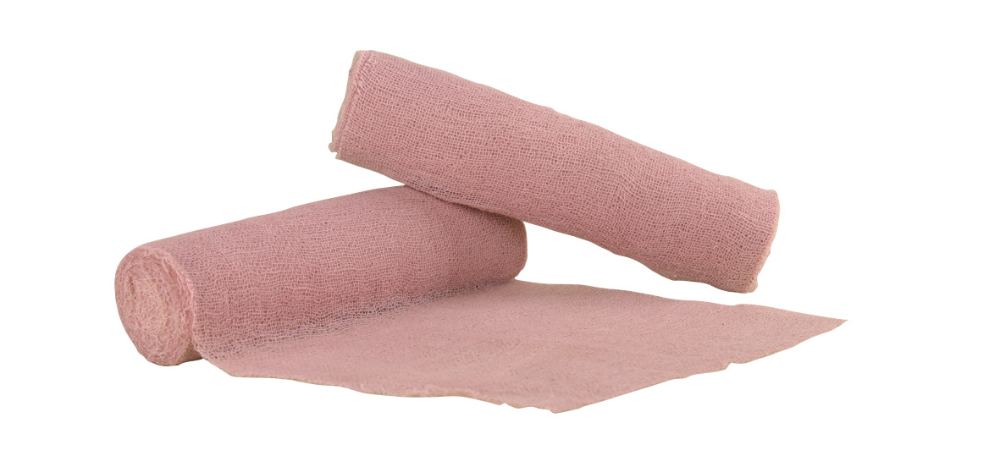
Gauze
Gauze exists to hold the absorbent pad in place.
Gauze is likely the easiest way to cause further injury if it is applied too tight
This can cause the injury to swell cutting off blood circulation and reducing the immune response
If you can’t easily slip one or two fingers under the bandage, it is too tight.
Try to overlap the gauze by a 1/3 of its width with each time around.

Slide 14
Gauze (cont.)
If you don’t have gauze, other elastic type materials work to temporarily hold the pad in place until gauze can be retrieved
The leg from a panty hose would be an example of a material that would work if need be.

Slide 15
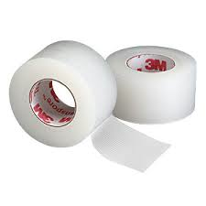
Tape
Tape secures the gauze and pad in a specific place on the pet’s body
Elastic adhesive bandages work best.
If none is available, and adhesive tape is better than none
If you have no adhesive tape, nonadhesive substances such as Saran Wrap can work temporarily.
In fact, a pet may tolerate this more because it sticks to itself and not to the fur

Slide 16
Tape (cont.)
Be sure that the tape covers a portion of the fur on both sides of the bandage
This is necessary to prevent the bandage from being worked loose and removed.
As with the gauze, make sure it is not too tight
Use the two finger test to ensure a proper fit
Remember, a wound needs to breathe!

Slide 17
What if you lack supplies?

Slide 18
Applying a Bandage
Step 1: Control the bleeding by applying direct pressure to the wound.
Use a sterile pad
Hold it in place (w/ hand or bandage)
Keep in place until the bleeding stops
If the pad soaks through, put another pad over the top
DO NOT remove the blood-soaked pad
It will also remove the platelets closing the wound!

Slide 19
Applying a Bandage
Step 2: Wound preparation
If the pet has long fur, clip it to prevent it from getting into the wound or sticking to it.
If using a scissors, hold the fur with your index and middle finger and clip above them, leaving a 1 inch border around the wound.
If the skin is broken, dab on a lubricant (water soluble, e.g. KY) – the trimmed fur will stick to the jelly and wash out easily
The best way to cleanse a wound is to flush it with cool water or sterile saline contact lens solution to float out debris.
If need be, you could use the spray attachment on a kitchen sink, or even a garden hose.

Slide 20
Applying a Bandage
Step 3: Antiseptic
Antiseptic: substance that inhibits the growth and reproduction of microorganisms.
Once the wound has been disinfected, gently dab it with gauze or a clean, lint-free cloth to clean any residue
Always see a vet for serious injuries.

Slide 21
Applying a Bandage
Step 4: Apply the layers of the bandage:
Absorbent Pad
Apply an unused, clean, and sterile pad that is large than the injury over the wound
Hold in place with your hand until the gauze is in place
Gauze
Wrap completely around the wound with gauze
Cover at least 1/3 of the previous loop of gauze with the overlying layer
Wrap at least 2-3 times, leaving enough space to fit two fingers
Tape

Slide 22
Applying a Bandage
Step 5: Daily checks and replacements
Replace bandages every 1 -2 days, check daily
Visually check the wound for the rate of healing and for possible infection

Slide 25
Assignment
In small groups 2-3 create two types of bandages
1. Traditional Bandage
2. Unique Bandage (look around the classroom, what materials could you use if you did not have bandage material?
When bandaged show Mrs. Propson get checked & get credit. Remember to use the criteria we discussed.
Any lack of disrespect of equipment/lab will be an automatic zero on the lab!

