Slide 1
STEM

Slide 2
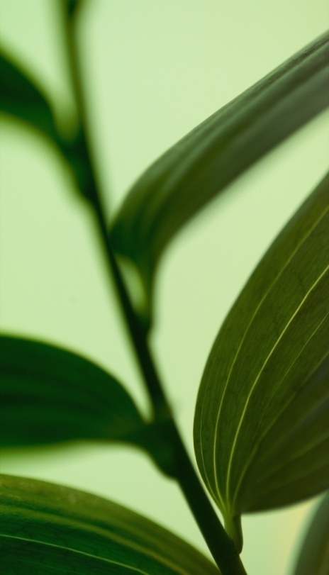
Stem Types
Herbaceous stems
Soft, green, flexible
Annuals, biennials, or perennials that die to the ground at the end of the growing season
Woody stems
Hard, produce secondary growth
May go dormant at the end of a growing season

Slide 3
Stem Functions
Move water, minerals, and manufactured food throughout the whole plant
Store food
Green stems help produce food through photosynthesis
  Not usually the primary food production, but important in plants with no or very small leaves

Slide 4
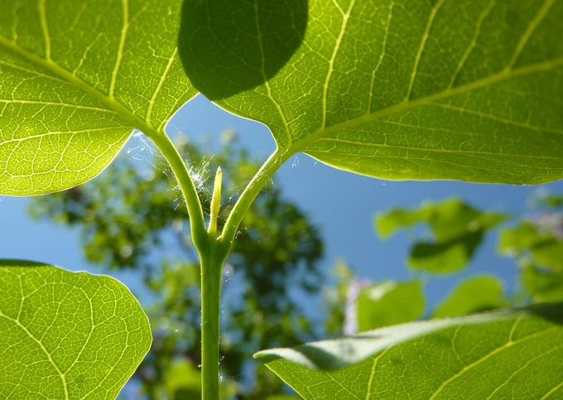
External Stem Structures
Apical meristem - growing point at the tip of the stem
Terminal bud - bud at the end of the stem
The apical meristem is the same type of structure as that found on the tip of the root, and it is responsible for growth in the length of the plant.

Slide 5
External Stem Structures (cont.)
Node = where leaf is attached to stem
Internode = area between leaves
Lateral bud = side bud - at node, just above where the leaf is attached
Bud scales = small protective structures, on outside of terminal and lateral buds
Leaf scar = Small scar just below the lateral bud from when the leaf falls off of the stem
Bud scale scar = ring of scars from when the buds sprout each spring & bud scales fall off
  The distance between bud scale scars represents one year’s growth of the stem.
Lenticels = small spots on stem, allow a stem to exchange gases

Slide 6
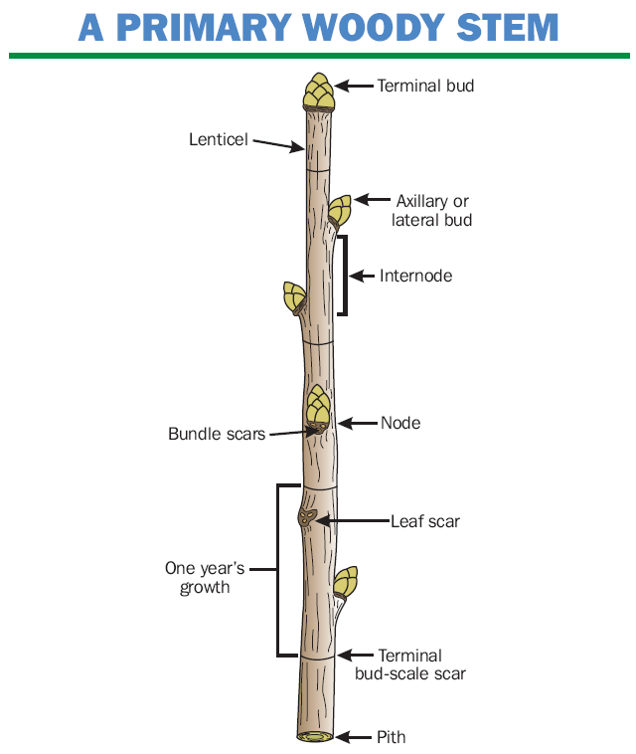

Slide 7
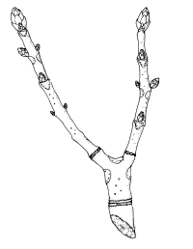
External Stem Structure

Slide 8
External Stem Structure
Apical Meristem
Bud Scale
Terminal Bud
Node
Axillary/Lateral Bud
Internode
Leaf Scar
One Year’s Growth
Lenticel
Bud Scale Scar

Slide 9
Specialized Stem Structures
We generally expect stems to be upright and above ground, many stems do not fit into this mold.
Some stems are modified to store food or help the plant reproduce. Some stems grow beneath the soil instead of above it.
Brainstorm examples of specialized stems……

Slide 10
Bulb
very short flattened stem
several fleshy leaves attached
tend to be found beneath the soil
example = onion
Corm
spherical structure
much like a bulb but entire structure, is stem as opposed to stem & leaves.
example = gladiolus

Slide 11
Rhizome
underground stem
lies horizontally
examples: hostas, mother-in-law’s tongue
Stolon
horizontal stem
lies above the ground
called runners (spread plant)
example: strawberries
Tuber
rhizome with swollen tip
stores food
example: potatoes

Slide 12
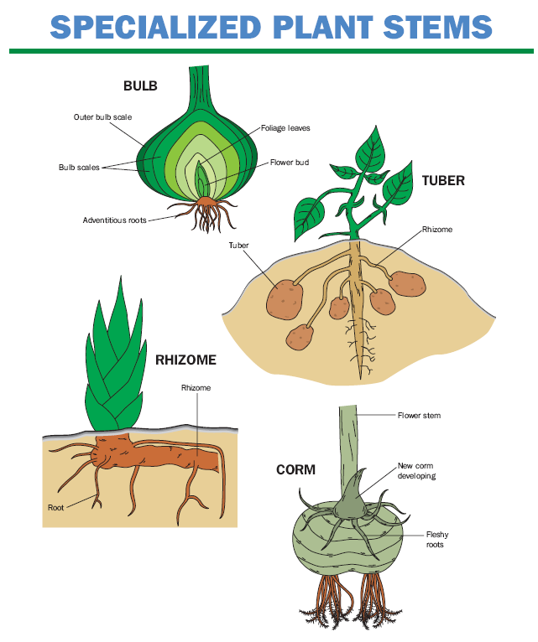

Slide 13
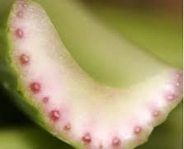
Internal Stem Structures
1. Xylem
Tissue conducts movement of water and minerals throughout the plant
Made of tube-like cells that grow together to conduct liquids
Tends to be found closer to the center of the stem

Slide 14
Internal Stem Structures
2. Phloem
Tissue that conducts/moves food (produced in the leaf) to the rest of the plant
Cells form tube
Generally found toward the outside of the stem

Slide 15
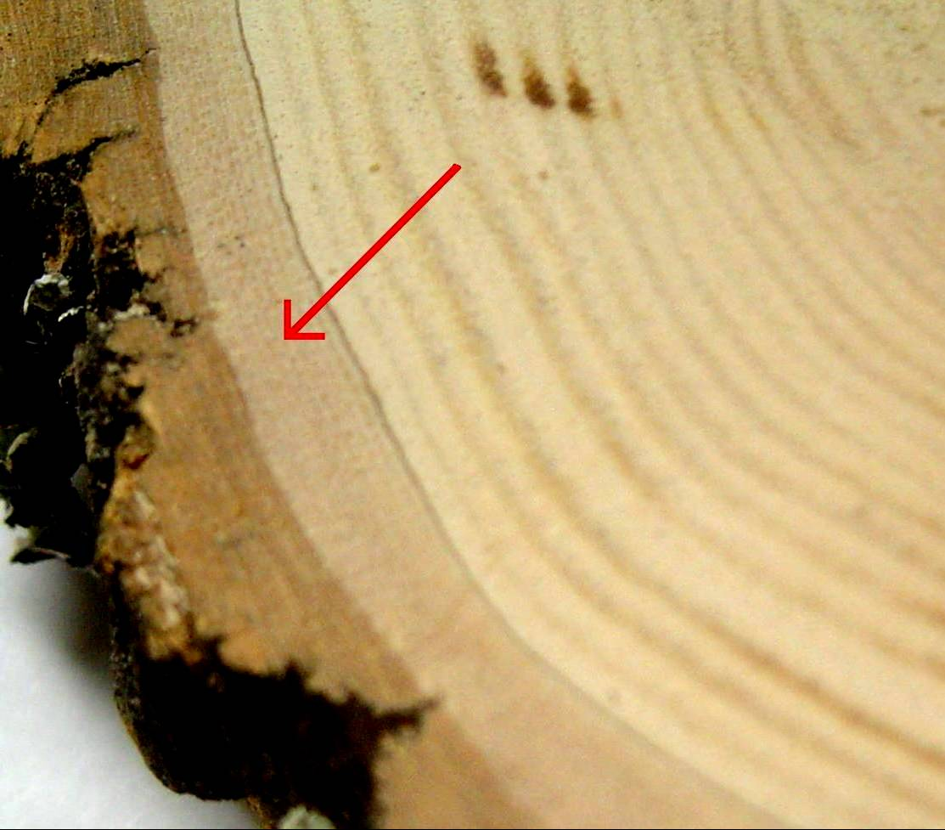
Internal Stem Structures
3. Cambium
Tissue responsible for the production of new xylem and phloem
Responsible for growth in the girth of the stem
Generally found between the xylem and the phloem

Slide 16
Translocation
Movement of materials through vascular tissues
XYLEM = dilute solution of water and dissolved minerals, ONLY ONE direction
PHLOEM = sugars move through the phloem, DIFFERENT direction

Slide 17
Monocot VS Dicot Stems
Monocot
Have epidermis that provides protection
Xylem & phloem are grouped in vascular bundles throughout stem extending entire length
Xylem inside, phloem outside, lack cambium
Dicot
Have epidermis with cortex for protection comprised of vascular bundles that form a ring
Xylem inside, phloem outside, cambium between
Center of the stem pith (storage)

Slide 18
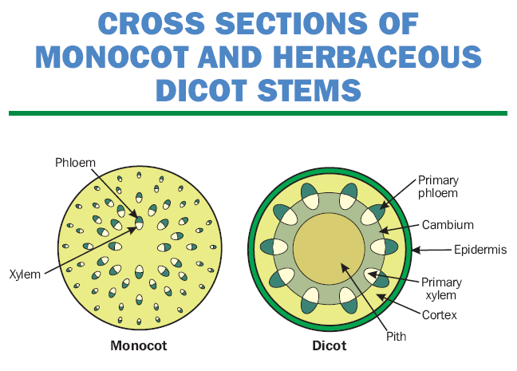

Slide 19
Heartwood VS Sapwood
Heartwood
darker wood to the center of the tree
xylem cells have filled with gums, resins, pigments, and tannins
  provide strength and no longer function in conducting materials
Sapwood
lighter wood circling the
younger sapwood actively conducts water and dissolved minerals

Slide 20
