Slide 1
Horticulture History

Slide 2
Hypothesize - TPS
Where did horticulture begin?
Where will the history of horticulture originate?
Who invented it?

Slide 3
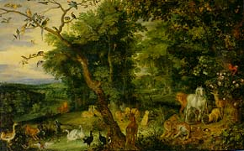
History of Horticulture
“Garden of Eden”
Romanticized garden of paradise.
Ultimate goal throughout history.

Slide 4
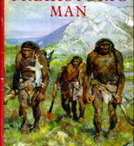
History of Horticulture
Prehistoric people were primarily….
Hunters and gatherers.
Collected seeds, fruits, and nuts.

Slide 5
History of Horticulture
Primitive people began to study plants.
Is it edible?
Does eating it modify well-being?
Does it taste good?
Can it used to keep me warm? As fuel? As clothing?
Is it useful to combat pain? Disease?

Slide 6
History of Horticulture
When were plants first cultivated?
Neolithic Age (7000 – 10000 years ago)
First farmers were women

Slide 7
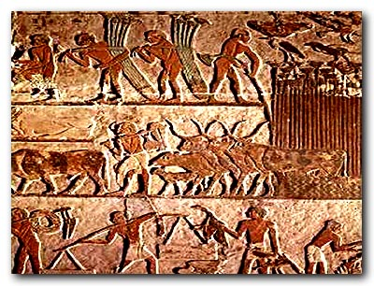
History of Horticulture
By 3000 B.C. in Egypt
Land preparation
Irrigation
Pruning

Slide 8
History of Horticulture
Meanwhile in Mesopotamia, Babylonia, and Assyria…..
Irrigation canals lined with burnt brick and sealed with asphalt joints.
This system kept 10,000 square miles under cultivation…..
Which fed 15,000,000 people
Cultivated roses, figs, dates, grapes, and olives.

Slide 9
History of Horticulture
Eventually people began asking questions
How do they reproduce?
How are they constructed?
How are they nourished?
How are they related to one another?
How are traits passed from one generation to the next?
How do they grow?

Slide 10
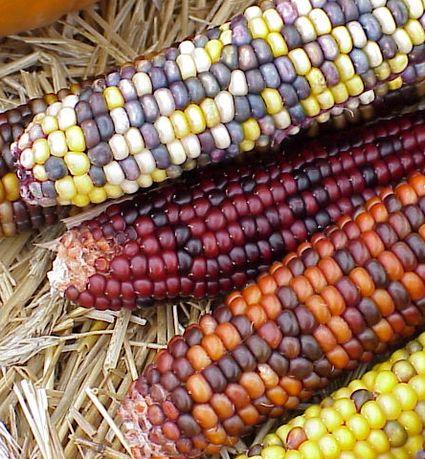
History of Horticulture
Meanwhile, back in America……
The Pre-Incas were cultivating maize (corn)

Slide 11
Hypothesize - TPS
What other crops were Native American’s growing?

Slide 12
History of Horticulture
Other Indian crops included……
Potatoes
Sweet potatoes
Peppers
Squash
Tomatoes
Cocoa

Slide 13
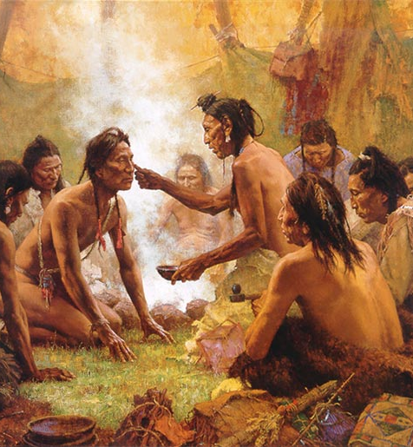
History of Horticulture
The use of plant products eventually led to physicians, pharmacists, and scientists.

Slide 14
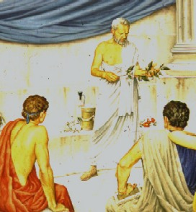
History of Horticulture
Theophrastus
1st scientific horticulturist
Student of Plato and Aristotle
Wrote the books History of Plants and The Causes of Plants.

Slide 15
History of Horticulture
History of Plants
Morphology of roots, flowers, and leaves.
Anatomical features such as bark, pith, fibers, and vessels.
The Causes of Plants
Relationship of weather, soils, and agricultural practices.
Importance of seeds
Value of grafting
Tastes and flagrances of plants
Death of plants

Slide 16
History of Horticulture
Renaissance
Rebirth of energetic attention to scientific discovery.
Taxonomy, morphology, and anatomy branches of botany began to grow.
More and more plants were discovered due to exploration which required a system of classification.

Slide 17
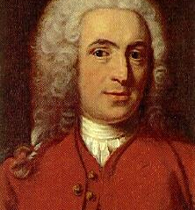
History of Horticulture
Linnaeus (1707-1778)
Swedish botanist.
Developed binomial classification (sci. name)
Based on their sexual or flowering parts.
Built upon the work of the Greeks, especially Dioscorides.

Slide 18
Horticulture in America
When the Europeans arrived they brought seeds, cuttings, and plants.
Orchards were established
Crops brought to America
Oranges
Wheat
Cabbage

Slide 19
Horticulture in America
Early horticulturists in America
John Bartram
George Washington
Thomas Jefferson
John Chapman
aka. Johnny Appleseed

Slide 20
Horticulture in America
New life in horticulture
Morrill Act of 1862.
Established land-grant universities.
Encouraged the growth of agricultural knowledge.

Slide 21
Horticulture in America
Liberty Hyde Bailey (1858-1954)
“Father of American Horticulture”
Educated at Michigan Agricultural College
Present Day Michigan State University
Then was a professor at Michigan Agricultural College and at Cornell University. Est. 1st Hort. Dept.
Established the (ASHS) American Society of Horticulture Science in 1903.

Slide 22
Modern Day Horticulture
New Cultivars
Plant-Water Relationships
Plant Nutrition
Nutrient Management Plans
Biotechnology
New Color Strains
The Rhizosphere
Integrated Pest Management
Plant Growth Regulators
Mechanization
Post Harvest Factors
Consumer lack of knowledge of food crops

Slide 23
Activity
Create a timeline with a partner using your horticultural history notes.
Include a minimum of the 10 most important events in your opinions
Add graphics and examples to PROVE why each event is so important/significant
Be professional and detailed in your work

