Slide 1
Suturing
Original by
Rance Redhouse
Lane Atene
Kyle John
Craig Kohn
Modified by
Jamie Propson
Materials from Boston School of Medicine and other sources

Slide 2
Sutures
Sutures are used to repair cuts in the body and keep the edges of the wound closed.
While small wounds can usually keep themselves closed, large wounds require additional assistance or they will re-open and delay healing.
Sutures can be made of absorbable material, wire, nylon, and other sources.
In lieu of suturing, a vet could also use metal staples or glue to close a wound.

Slide 3
Preparing the Wound
First, trim or shave the area surrounding the wound to avoid contamination and to ensure proper airflow.
The wound edges should be exposed and clearly visible.
Ideally, there should be a half-inch diameter of hair-free skin surrounding the wound.
Washing and rinsing the wound will remove bacteria and debris.
Use soap to gently wash the skin wound and surrounding tissue.
Allow warm water to flow over and into the wound for a period of two full minutes.
Source: http://www.flickr.com/photos/olatheanimalhospital

Slide 4
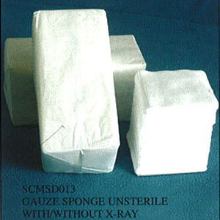
Preparing the Wound (cont.)
Following wound irrigation, pat the wound dry using a sterile gauze pad.
A clean paper towel can also be utilized to dry the surrounding area.
Avoid using cloth towels, as this can simply transfer additional bacteria to the clean wound.

Slide 5
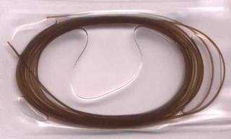
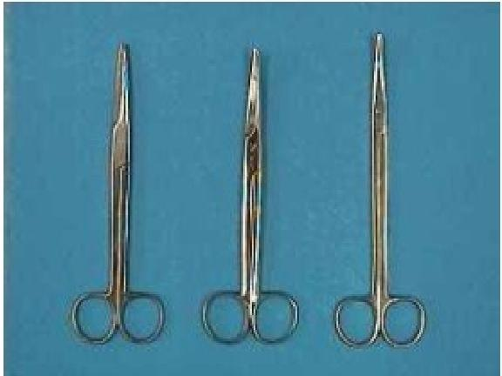
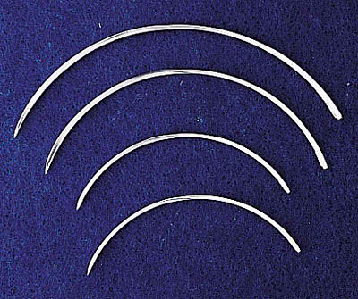
Supplies
Materials Needed for Suturing

Slide 6
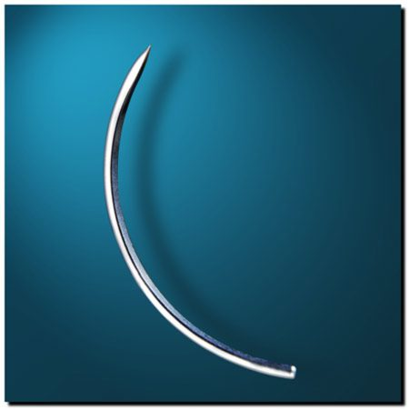
Curved Needle
Curved needles are used most often in the suturing process.
The curved needle are shaped like an arc to make the job easier and faster.
This needle can be used for any type of suture.
The size of the needle depends on the tissue to be sutured.
Thinner tissue requires a smaller needle.

Slide 7
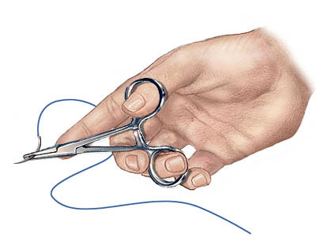
Needle Holders
A needle holder is a surgical instrument used to hold a suturing needle for closing wounds during suturing and surgical procedures
It may have both a serrated portion and a cutting portion (for holding the needle and cutting the stitching material).

Slide 8
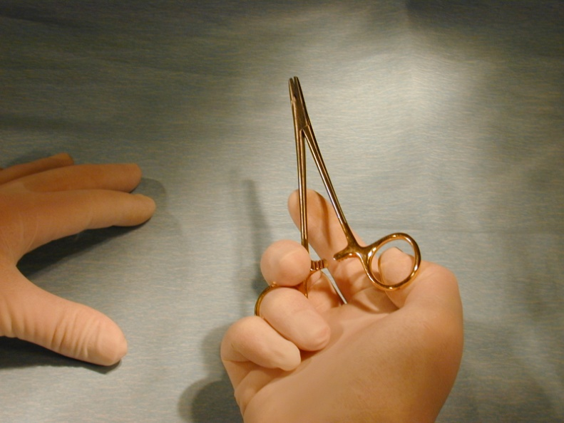
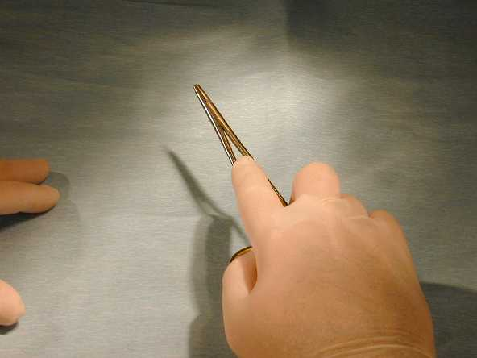
Needle Holding Techniques
There are several techniques for holding the needle holder.
The most common method is to place the thumb and middle or ring finger slightly into the instrument’s rings.
Avoid inserting your fingers far into the rings of the instrument, since this will tie up your fingers and impede your mobility.
Some surgeons do not put their fingers into the rings at all and simply grasp the rings and body of the needle holder in the palm of their hand.
Source: Boston University Medical Campus

Slide 9
Suture Materials
Suture materials can be divided into two categories: absorbable and non-absorbable.
Absorbable materials have the advantage in that they are less likely to cause an immune response by the body
Non-absorbable materials can be left in the body permanently if needed.

Slide 10
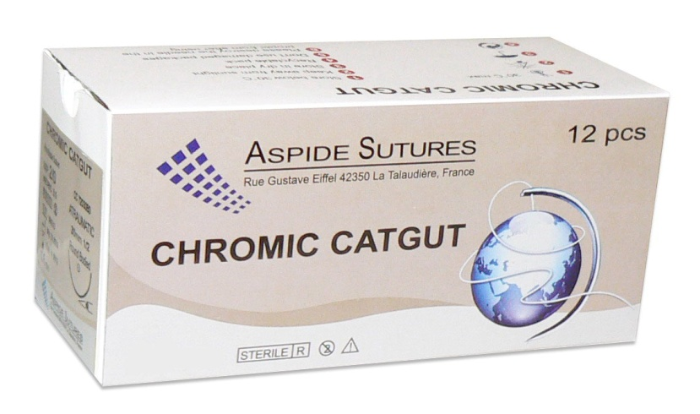
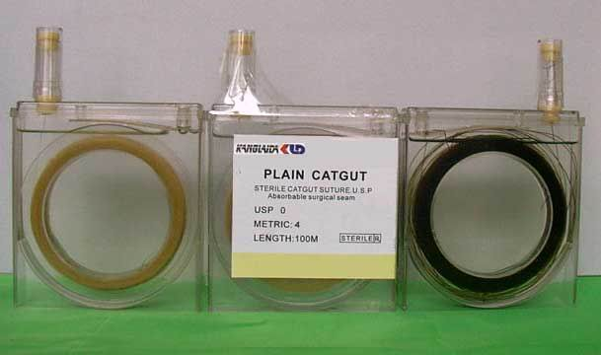
Absorbable Suture Materials
Absorbable suture materials are broken down by the patient’s body.
The original absorbable material was chromic catgut (still used today).
This is made from animal intestines and breaks down after 7 days.
Because absorbable materials break down, there is less of a likelihood of an severe immune reaction.

Slide 11
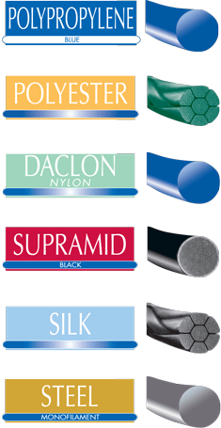
Non-absorbable Suture Materials
Non-absorbable sutures are made of materials that are not readily broken down by the body’s enzymes or by hydrolysis.
Non-absorbable materials can be removed or left in place permanently
Source: Boston University Medical Campus

Slide 12
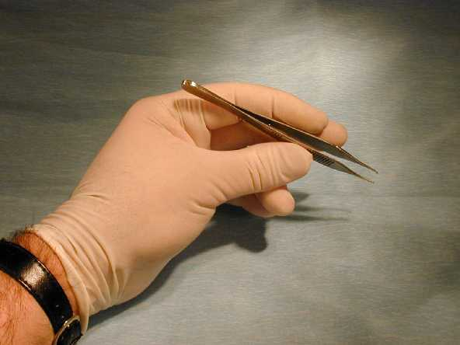
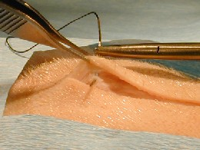
Forceps
Forceps allow you to control the position of the skin to make it easier to pass the needle and suture material through the skin.
Source: Boston University Medical Campus

Slide 13
Types of Sutures
Continuous Sutures
Non-continuous Sutures
Purse-String Suture

Slide 14
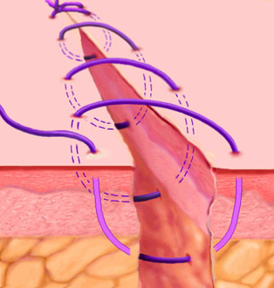
Continuous Suture
A continuous suture, also called uninterrupted suture, is made from an uninterrupted series of stitches that are fastened at each end by a knot.
A.k.a. Running Stitch
This suture is fast and lessens the risk of infection.

Slide 15
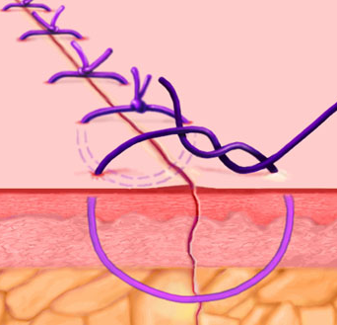
Non-Continuous Suture
A non-continuous suture, also called an interrupted stitch, is where each stitch is tied separately.
This stitch has the benefit of creating a more accurate fit for the edges of the wound.

Slide 16
Pro’s and Con’s
Continuous Sutures
+ It is faster.
+ It brings less foreign material in wound.
+ It is potentially more airtight/watertight.
- If one knot fails, it is a big deal.
- Less control over tension.
Non-continuous Sutures
+ This allows for adjustment of tension.
+ If one knot fails, it is not a big deal.
- More time is needed.
- Costs more.
- Increased amount of foreign material in wound.
Courtesy of J. James

Slide 17
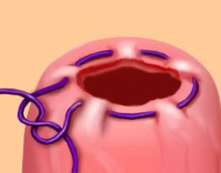
Purse-string Suture
A purse-string suture is a continuous stitch paralleling the edges of a circular wound.
This is commonly used to close circular wounds, such as hernia or an appendiceal stump

Slide 18
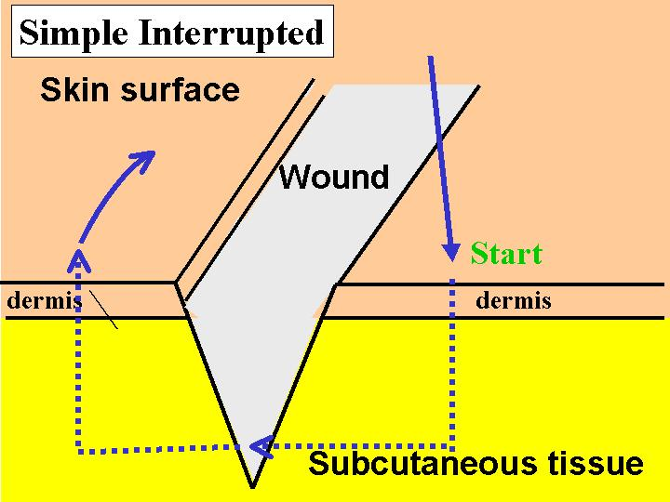
Remember to create right angles
The ideal skin suture should form a rectangle.
It should penetrate the epidermis and dermis perpendicular to the skin surface
After penetration, turn at a right angle, at the depth of the wound, move parallel to the skin surface, and then move straight to the surface.

Slide 19
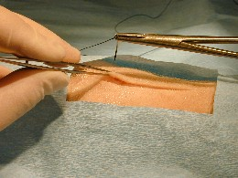
Forceps & Needle (Cont)
The tip of the needle should now be seen protruding into the wound
At this point, continue to hold the skin w/ the forceps.
A common error here is to release the forceps from the skin edge
This would cause the skin to retract, and the needle may move and retract beneath the skin edge

Slide 20
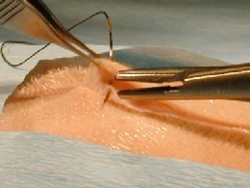
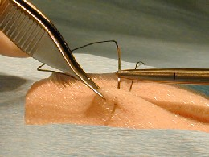
Forceps and Needle (cont)
The key is to hold the position of the skin edge while releasing the needle from the needle holder.
Pull the needle from the other side of the elevated skin.
Elevate the other skin edge and penetrate it with the needle.

Slide 21
Suture Removal
Sutures should be removed from the…
Face: 3-4 days
Scalp: 5 days
Trunk: 7 days
Arm or leg: 7-10 days
Foot 10-14 days

Slide 22
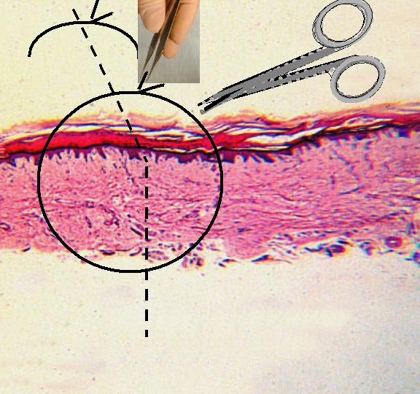
Suture Removal Steps
The first step in suture removal is that the skin should be cleansed.
Hydrogen peroxide is a good choice for gently removing dried blood and exudate.
Grasp one of the “ears” of the suture with a forceps to elevate the suture just enough to slip the tip of a small scissor under the suture in order to cut it.
Source: Boston University Medical Campus

Slide 23
Suture Removal Steps
With the suture gently elevated, snip the suture with a scissors.
The suture is then gently removed by pulling with the forceps.
It is frequently a good idea to reinforce the wound with adhesive strips or tape to prevent it from re-opening.

