Slide 1
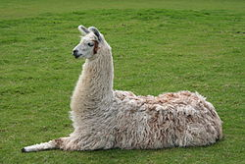
What am I?
Notes:
Llama

Slide 2
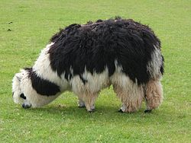
What am I ?
Notes:
Alpaca

Slide 3
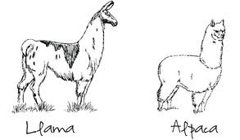
What Are Major Differences Between Llamas and Alpacas?

Slide 4
Differences
Alpacas
Llamas
400+ pounds, 6ft tall
Coarse outer fleece, softer inner fleece
Brave
Can carry heavy packs
Heard guards
Roughly twice as large as alpaca but produces much less fiber
150 pounds, 3-4ft tall
Soft, luxurious fleece in a single coat
Gentle and timid
Can learn tricks
Need protection

Slide 5
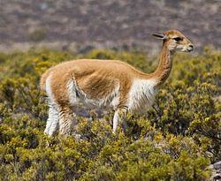
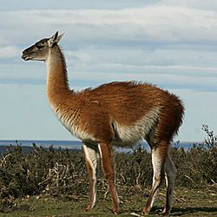
Camelid Family - (Similarity)
Cameidae (camelid) family includes camels, llamas, alpacas, vincunas and guanacos (S.A)

Slide 6
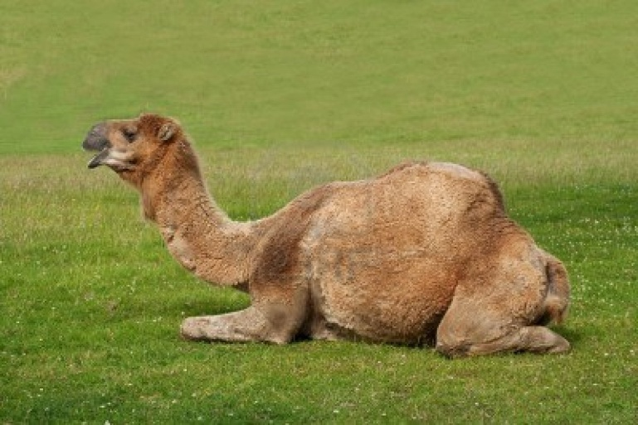
About Camelids
Large Animals
Slender Necks
Long Legs
Herbivores
Not a True Ruminant (canine teeth and tusk like premolars)
Legs are attached to body at the top of the thigh only (why they rest on their knees with legs under boy)

Slide 7
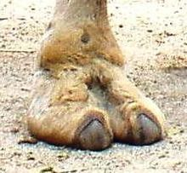
Camelid feet lack functional hooves, instead have two toed feet in a soft footpad

Slide 8
Llama Reproduction
Unusual reproduction: induced ovulators (when they mate the female releases an egg is usually fertilized on first attempt) (no estrus)
Males reach sexual maturity at 3 years of age, females at 1 year of age
Mate in kush position (lying down) for 20-45 minutes
Gestation = 350 days
Do not lick off newborn (tongue cant reach) instead nuzzle newborn and hum.
Give birth standing

Slide 9
Llamas
Young are called Cria (up and walking within a hour of birth)
Live 20-30 years
Social Animals/Herding – easily trained
Spitting uncommon when trained correctly
Soft, lanolin-free fiber (worth more than wool)
Cleaner (less oil/grease to collect dirt)
Are Llamas Omnivores? How does this hurt ag. education and fuel ag misconceptions?
http://www.youtube.com/watch?v=SJixW2u4IvQ&feature=fvwrel

Slide 10
Alpaca
Herds
Very common in Andes Mountains of South America
Bred for fiber
Knitted and woven items such as blankets, sweaters, hats, gloves, etc.
52+ natural colors of fiber in Peru, 16 natural colors in US
Adult Male is 39 inches at the withers (how many hands is this?)
Not all spit, but all can, usually at other alpacas

Slide 11
Alpaca
Common dung pile – decreases parasites
Can be house trained
Make a variety of sounds when scared such as a whine or click
Also induced ovulators
Females mature 1-2 years of age
Males mature 1-3 years of age
Gestation is 345 days, twins rare, cria = young
Three chamber stomach (many plants are poisonous to alpaca)

Slide 12
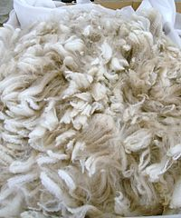
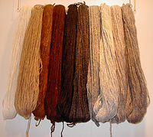
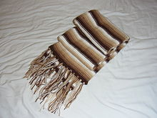

Slide 13
http://www.youtube.com/watch?v=vA-4M-xIGEs

