Slide 1
Lipids = Fats

Slide 2
What are lipids?
One of a group of compounds, including fats, phospholipids & steroids, that mix poor, if at all, with water

Slide 3
What is the function of fats?
Provides essential fatty acids-which your body cannot manufacture
Maintenance of healthy skin
Provide energy storage
Regulation of cholesterol
Regulation of metabolism
Carry fat-soluble vitamins
Helps the body use carbohydrates & proteins more efficiently

Slide 4
What happens if we don’t have enough fat in our foods?
Dry, scaly skin
Hair loss
Low body weight
Cold intolerance
Bruising
Poor growth
Lower resistance to infection
Poor wound healing
Loss of menstruation

Slide 5
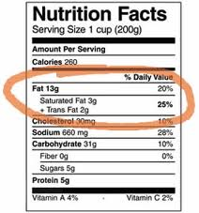
Trans fats & Saturated Fats – Bad Fats
Can lead to cardiovascular disease, heart disease & stroke
Mostly from animal products
Long lasting – usually don’t spoil quickly
Solid at room temp
contains only single bonds between carbon atoms, no double bonds

Slide 6
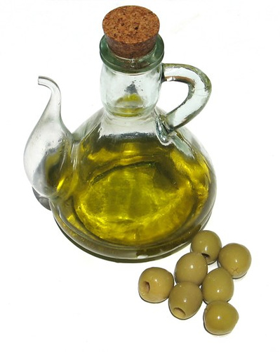
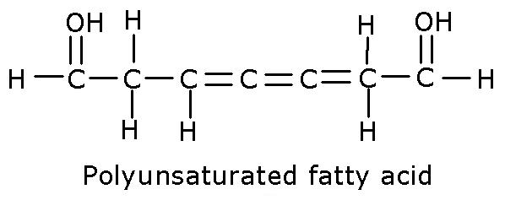
Polyunsaturated & Monounsaturated Fats – Good Fats
Mostly from plants
Lifespan = usually spoil quickly
Liquid at room temperature
contains one or more double bonds between carbon atoms -monounsaturated -polyunsaturated

Slide 7
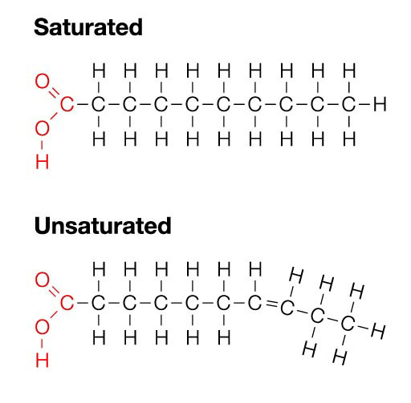

Slide 8
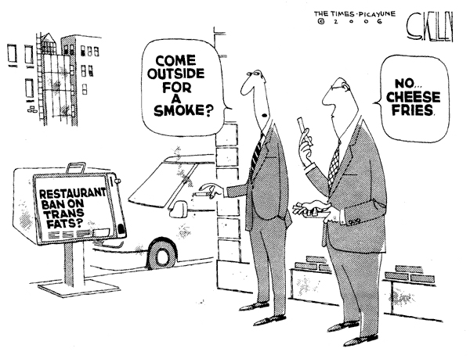
Why are fats in foods?
Provide a source of essential fatty acids
Add caloric density (energy)
Carriers for flavors
Carry fat soluble vitamins
Contribute to texture & mouthfeel
Provide heat transfer medium (frying)

Slide 9
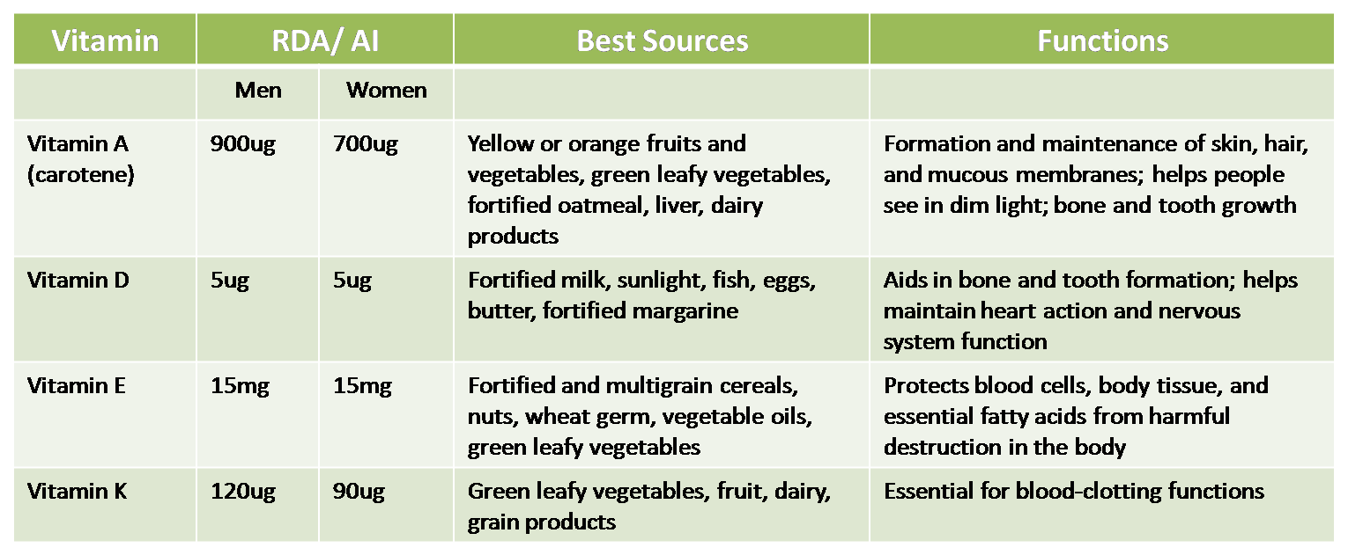
Fat Soluble Vitamins

Slide 10
What is the RDA for fats?
RDA = recommended daily allowance
Fats – use sparingly

